Slide 1
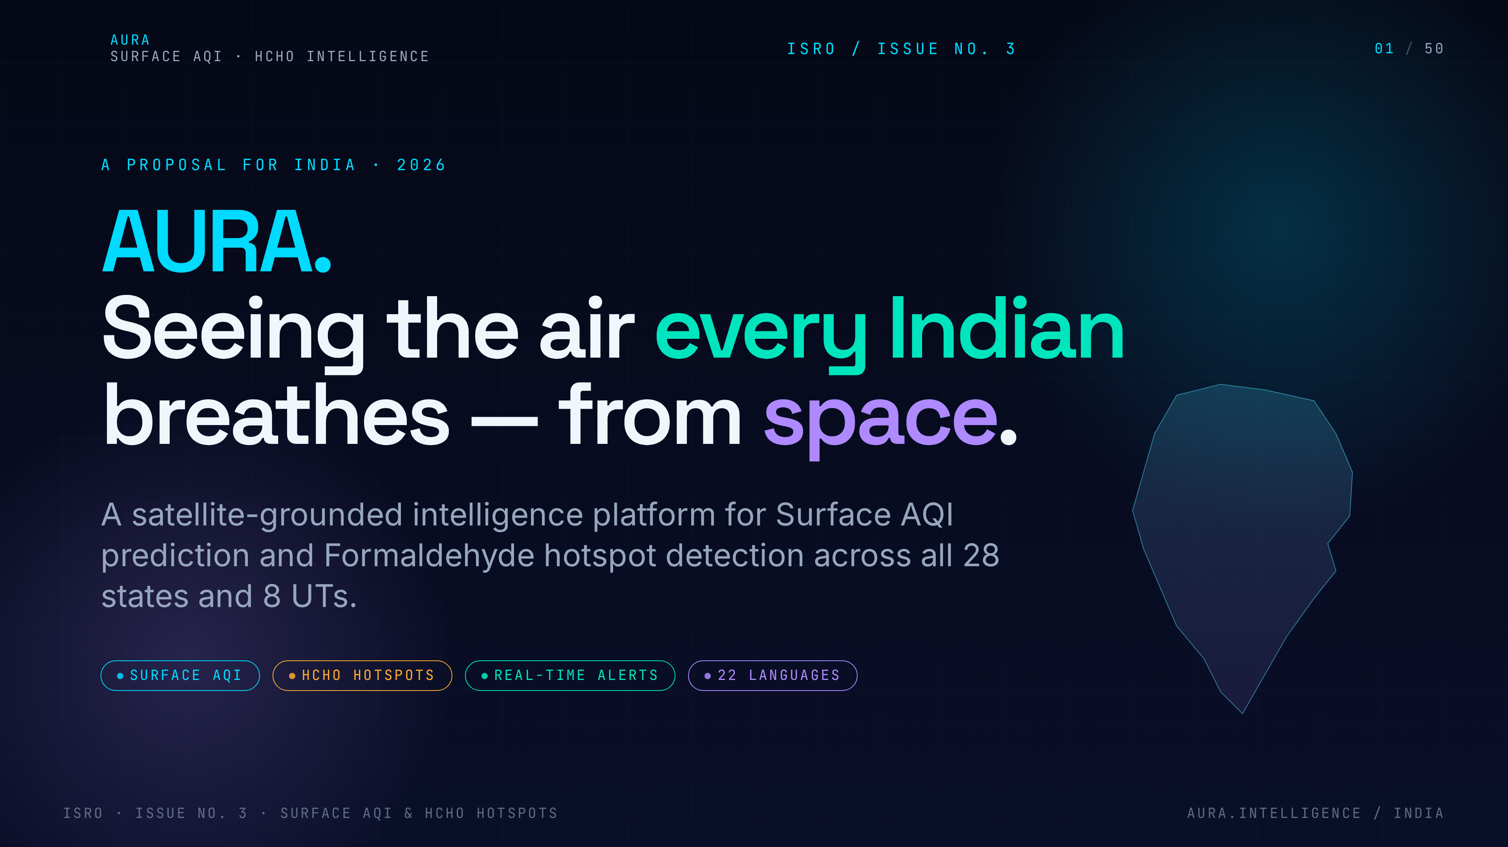
Notes:
1. AURA — Cover
Open warmly. AURA is a satellite-grounded intelligence platform that gives every Indian — urban or rural — a real-time read on the air they breathe. Frame this as ISRO Issue No. 3 with national reach.

Slide 2
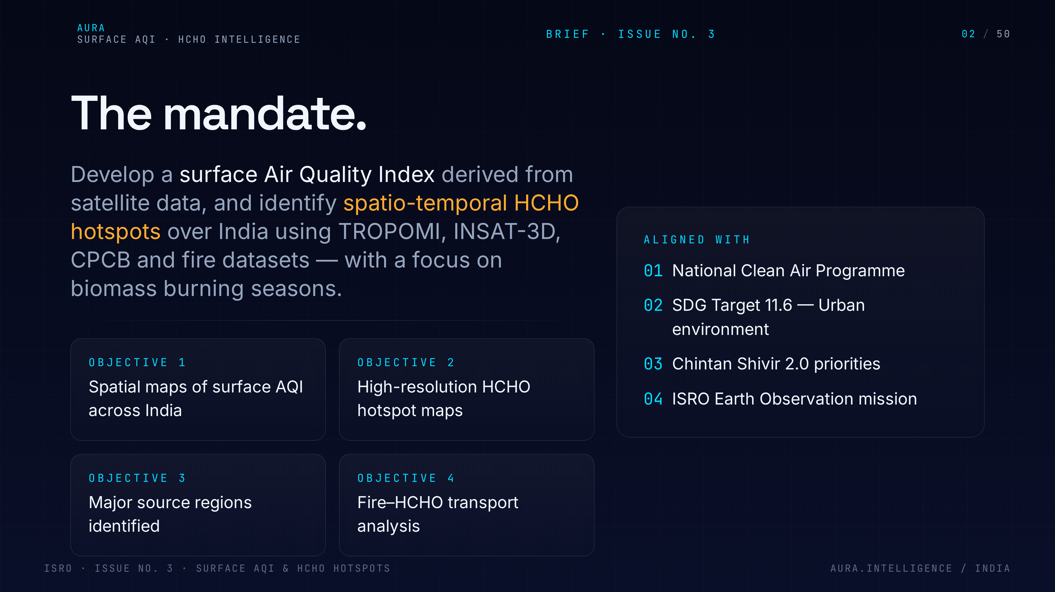
Notes:
2. The mandate
Restate the brief in our own words. Four crisp objectives: surface AQI maps, HCHO hotspots, source identification, and fire-to-HCHO transport. Tie it to NCAP and SDG 11.6 so reviewers see policy alignment.

Slide 3
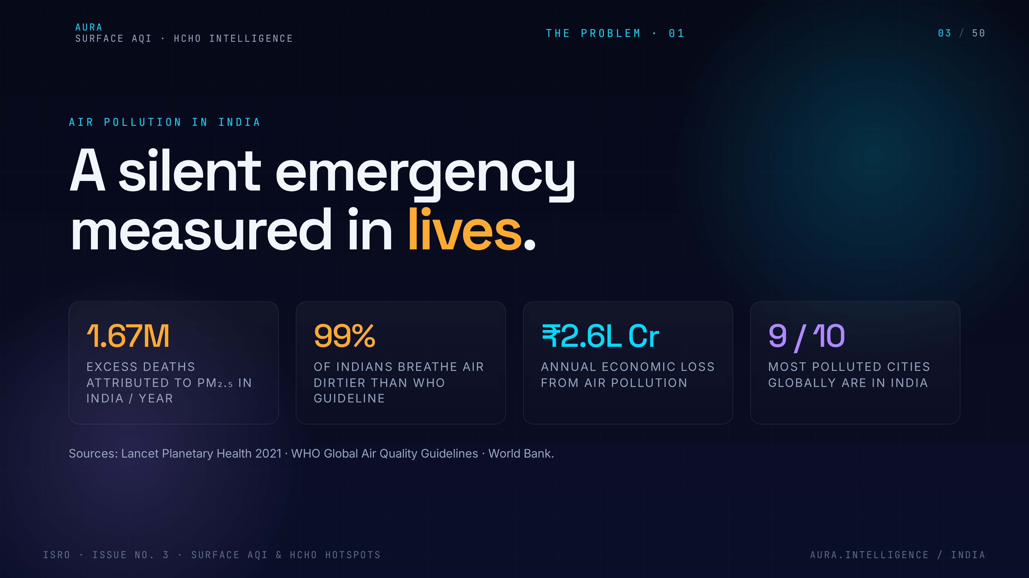
Notes:
3. Scale of harm
Anchor the stakes in numbers people remember: 1.67 million deaths a year and 99% of Indians breathing unsafe air. This is not an environmental story, it is a public health emergency.

Slide 4
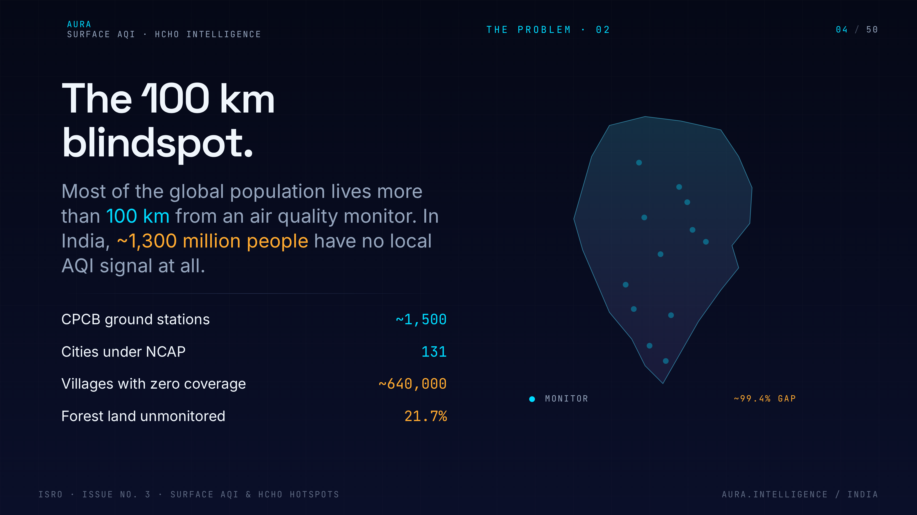
Notes:
4. The 100 km blindspot
Explain the monitoring gap. CPCB stations cluster in metros; 1.3 billion Indians have no nearby AQI signal. Satellites are the only way to cover that blindspot at national scale.

Slide 5
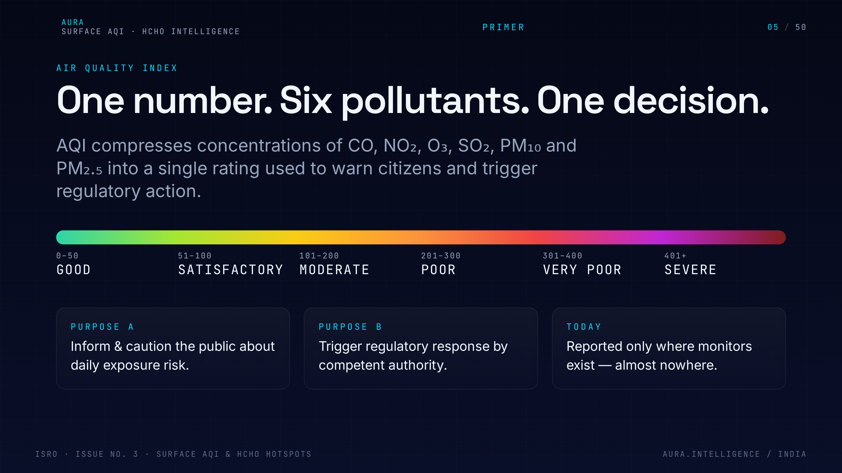
Notes:
5. What is AQI
Primer for non-technical reviewers. AQI compresses six pollutants into one 0-500 number with a colour and a health advisory. We will compute it from space, not just from a sparse station network.

Slide 6
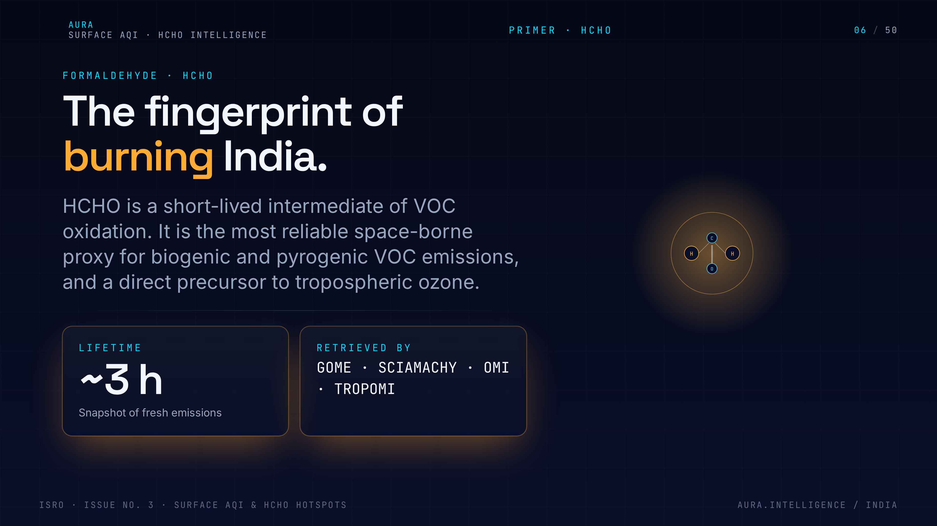
Notes:
6. Why HCHO matters
HCHO — formaldehyde — is a short-lived VOC, a marker of biomass burning, vehicles and petrochemicals, and a precursor to ground-level ozone. Tracking HCHO tells us where pollution is being created, not just where it is sitting.

Slide 7
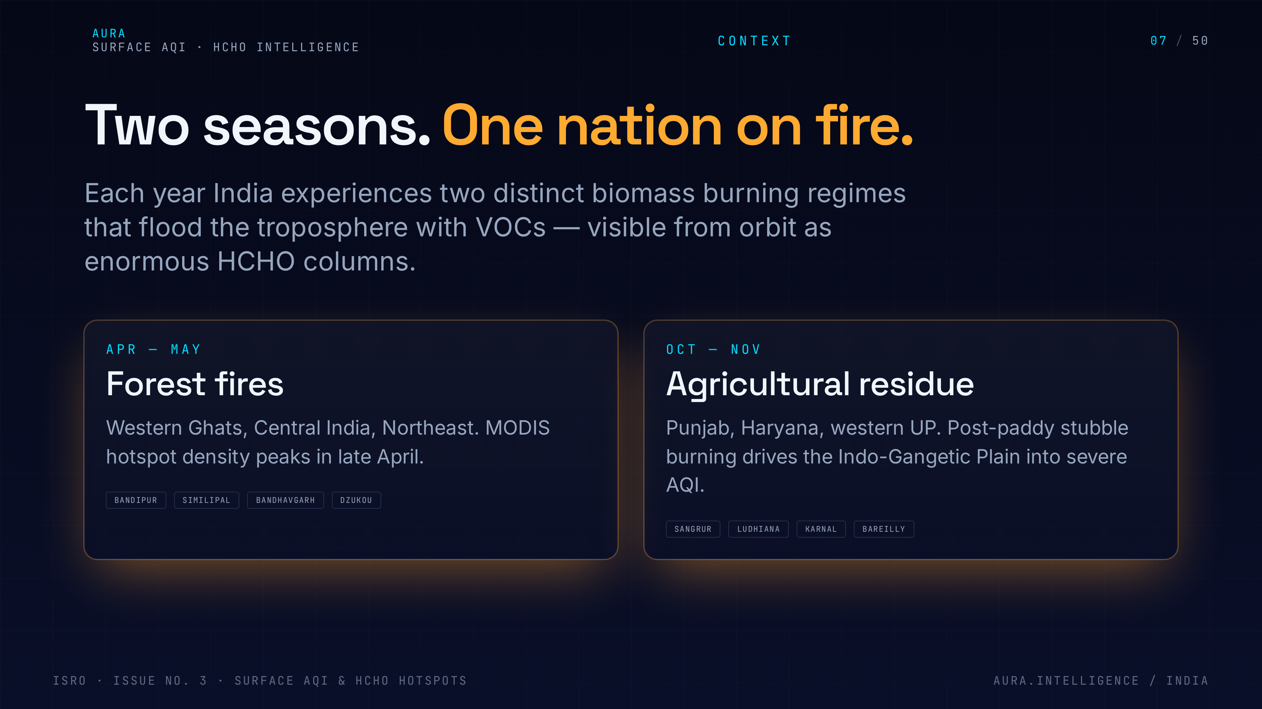
Notes:
7. Two burning seasons
India has two predictable burning seasons: post-monsoon stubble in the north (Oct-Nov) and pre-monsoon forest fires in the central belt (Mar-May). Our pipeline is designed around those windows.

Slide 8
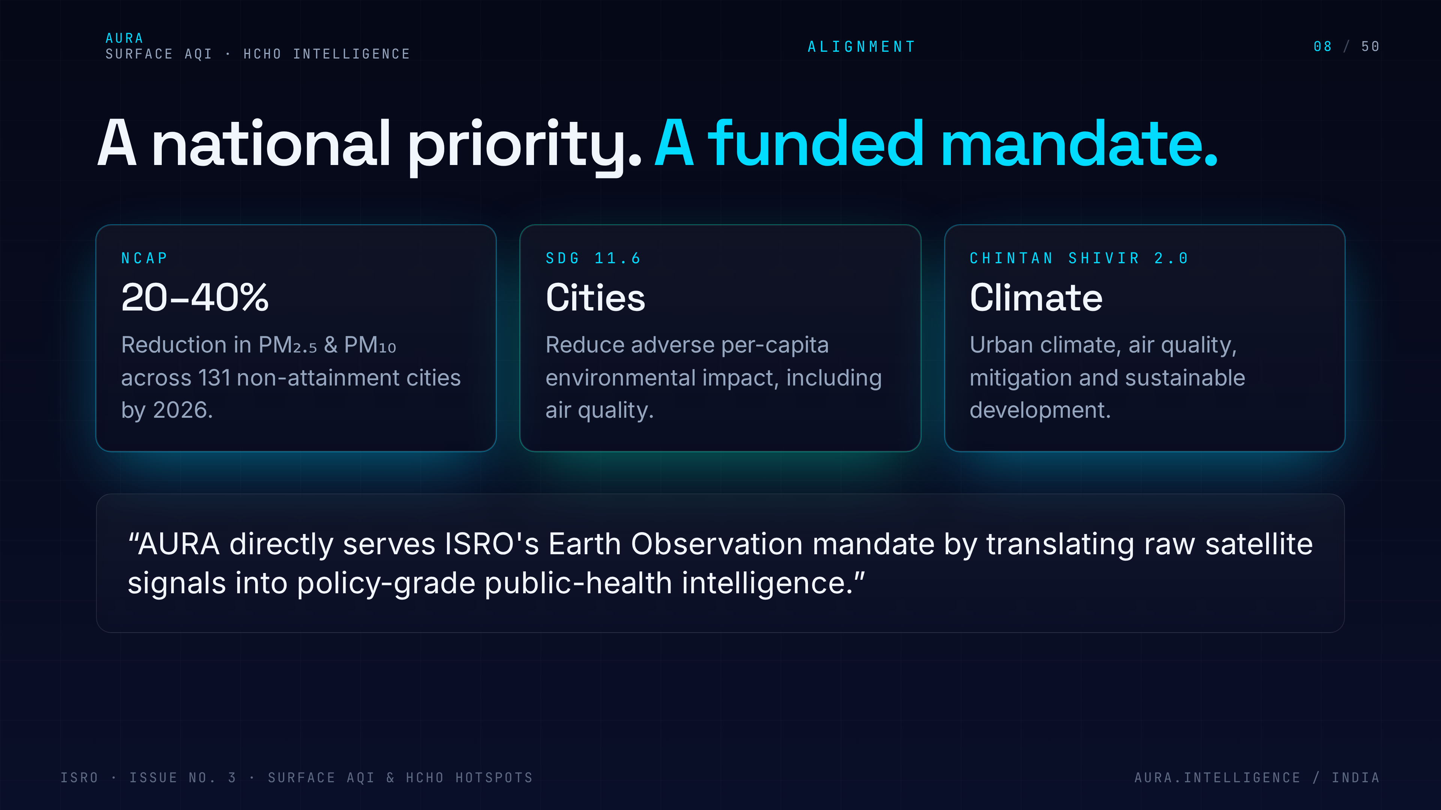
Notes:
8. National priorities
Show this is not a science project — it plugs into existing policy: NCAP targets, SDG 11.6, Chintan Shivir 2.0, and ISRO's EO mission. Reviewers want to see institutional fit.

Slide 9
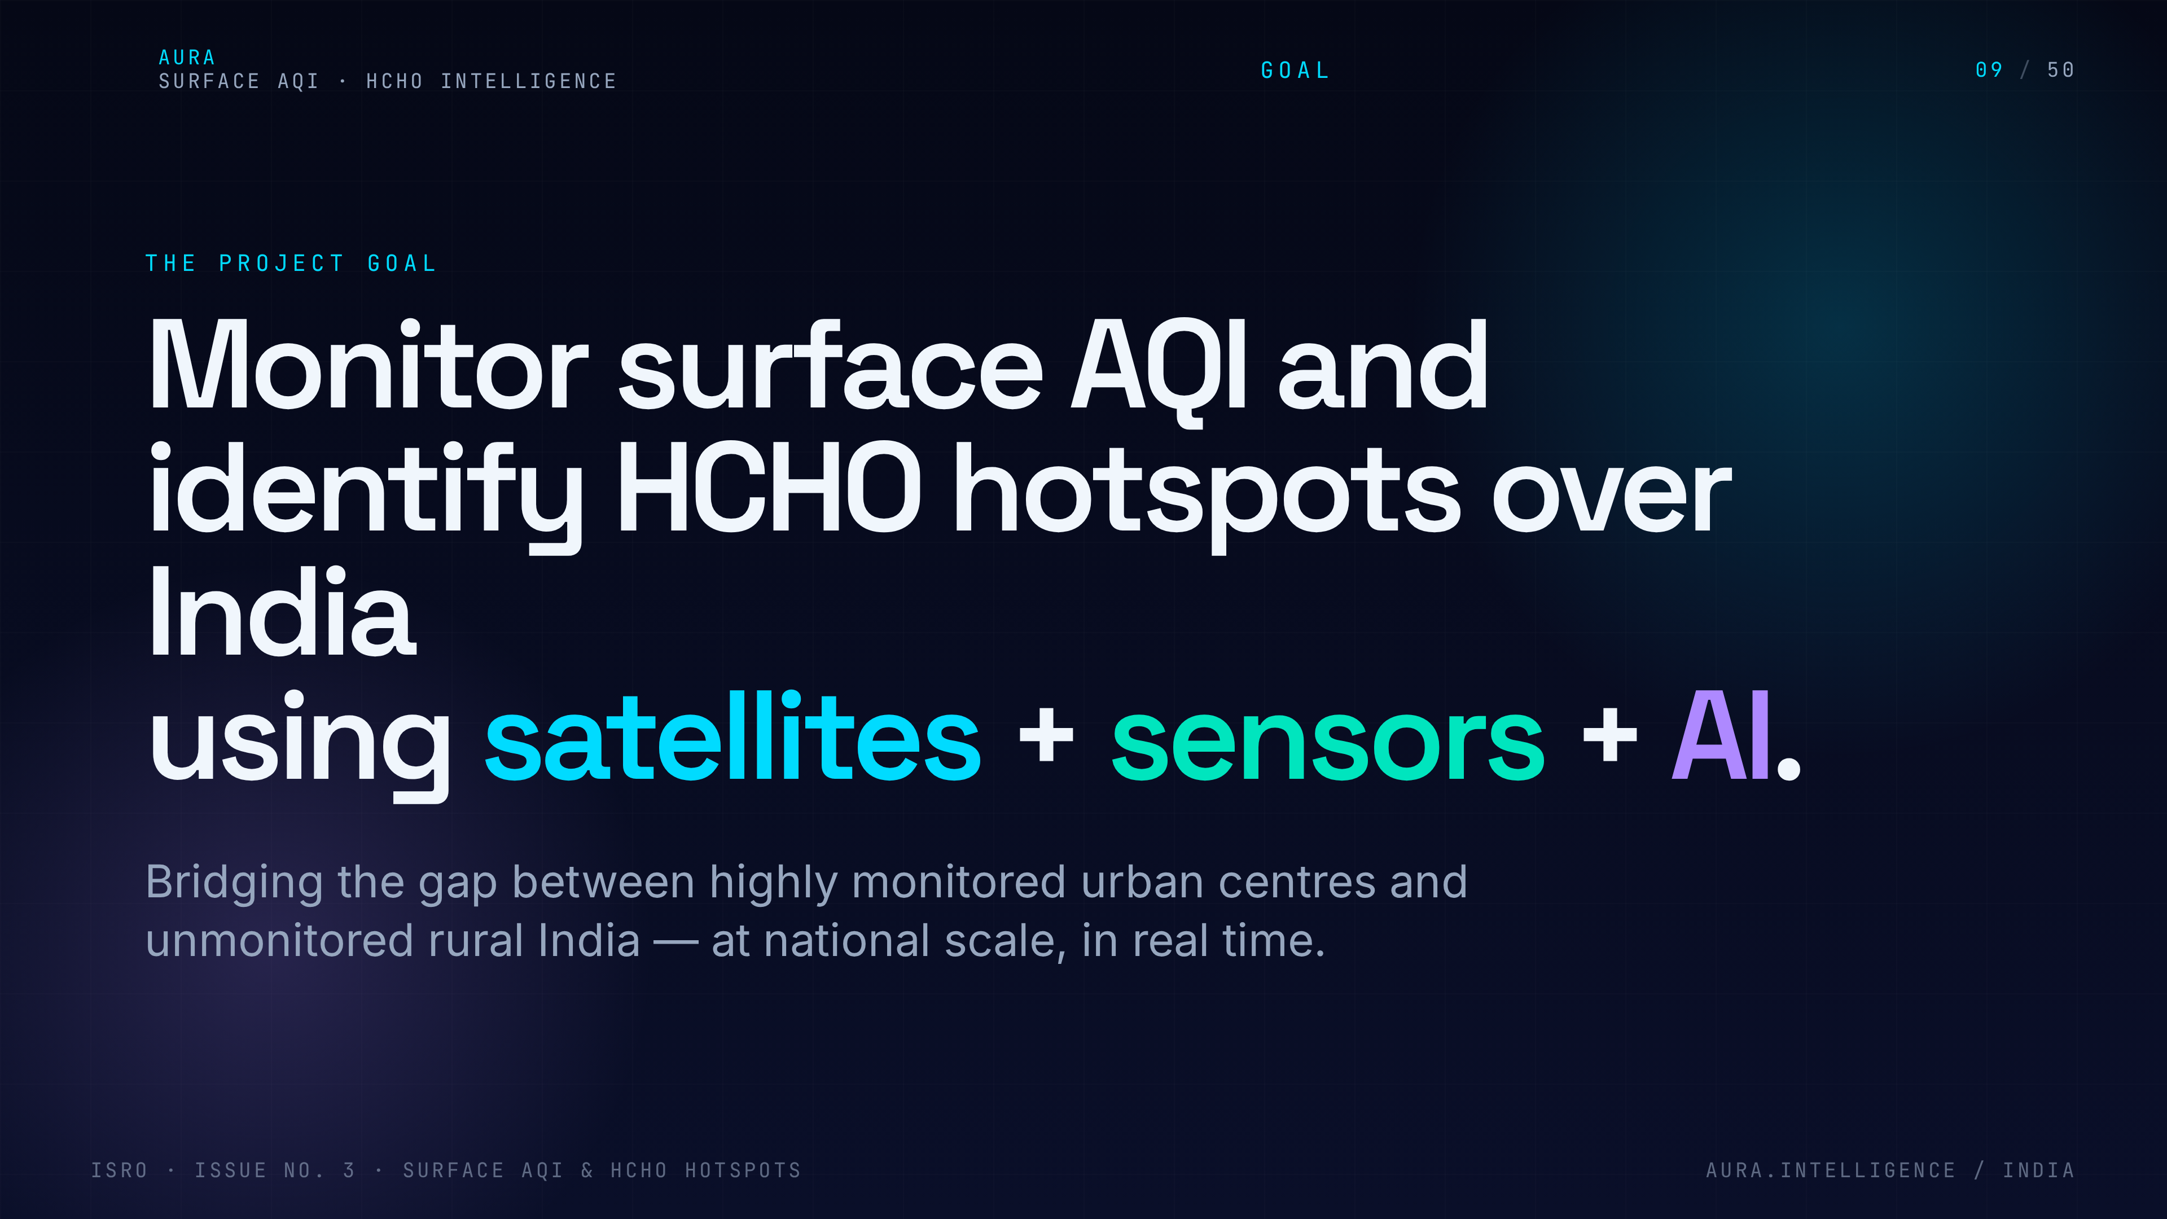
Notes:
9. Project goal
State the single project goal in one breath: deliver a 1 km surface AQI map for all of India and a high-resolution HCHO hotspot product, with actionable alerts. Everything that follows serves this goal.

Slide 10
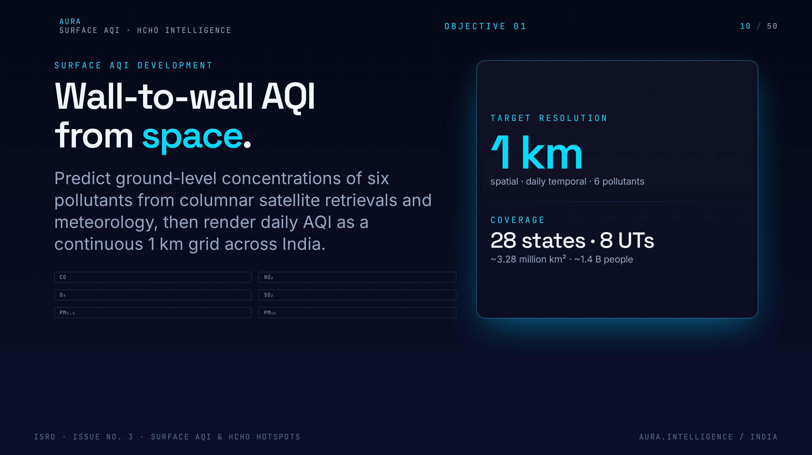
Notes:
10. Surface AQI
Objective 1 in detail — surface AQI. Today most satellite AQI products are columnar; we will translate column to surface using ML and meteorology, validated against CPCB stations.

Slide 11
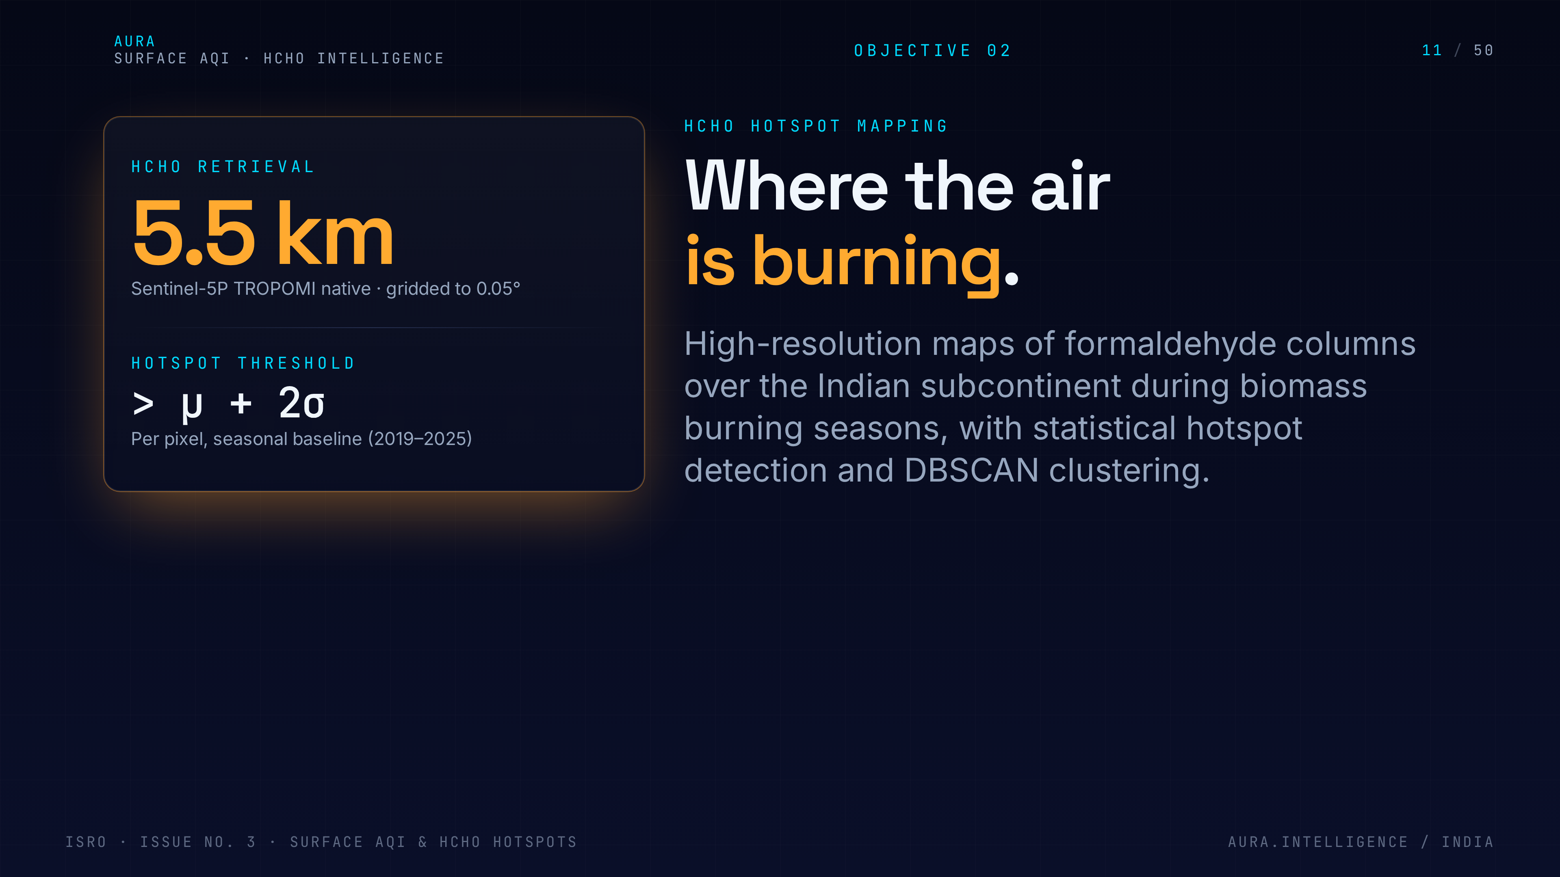
Notes:
11. HCHO hotspots
Objective 2 — HCHO hotspots. We move from monthly TROPOMI averages to spatio-temporally resolved clusters that we can attribute to specific fire events or industrial zones.

Slide 12
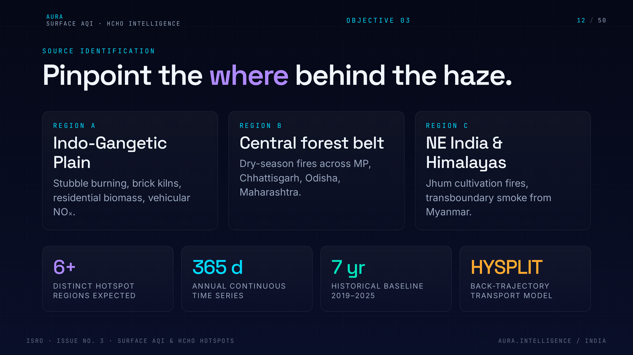
Notes:
12. Source identification
Objective 3 — source identification. Combine HCHO plumes with MODIS/VIIRS fire pixels and wind reanalysis to point at the burning district, not just the smoke.

Slide 13
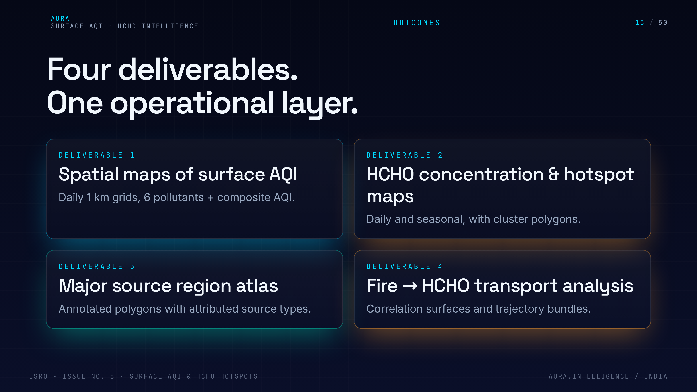
Notes:
13. Expected outcomes
Summarise the four expected outcomes — surface AQI database, HCHO hotspot maps, source attribution, and an alerts/advisory layer. This is the deliverable list reviewers will grade us on.

Slide 14
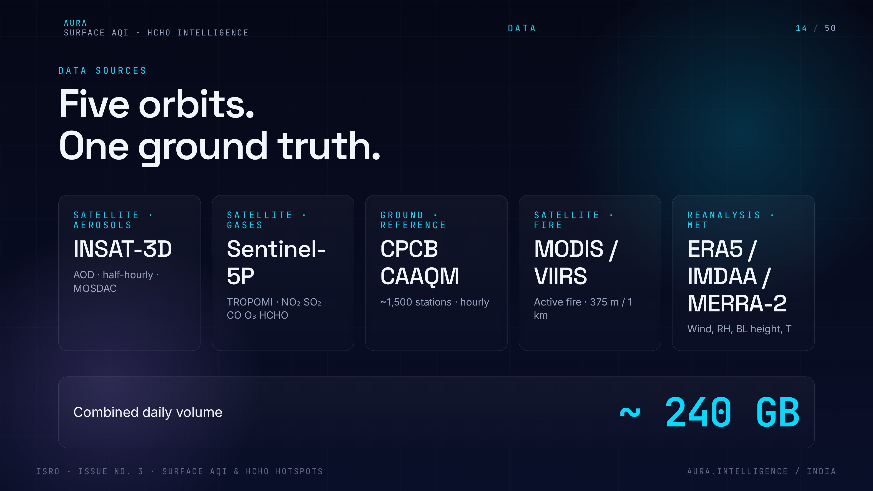
Notes:
14. Five sources
Walk through the five data sources at a glance: INSAT-3D, Sentinel-5P TROPOMI, CPCB ground truth, MODIS/VIIRS fire, ERA5 meteorology. Each one fills a specific gap.

Slide 15
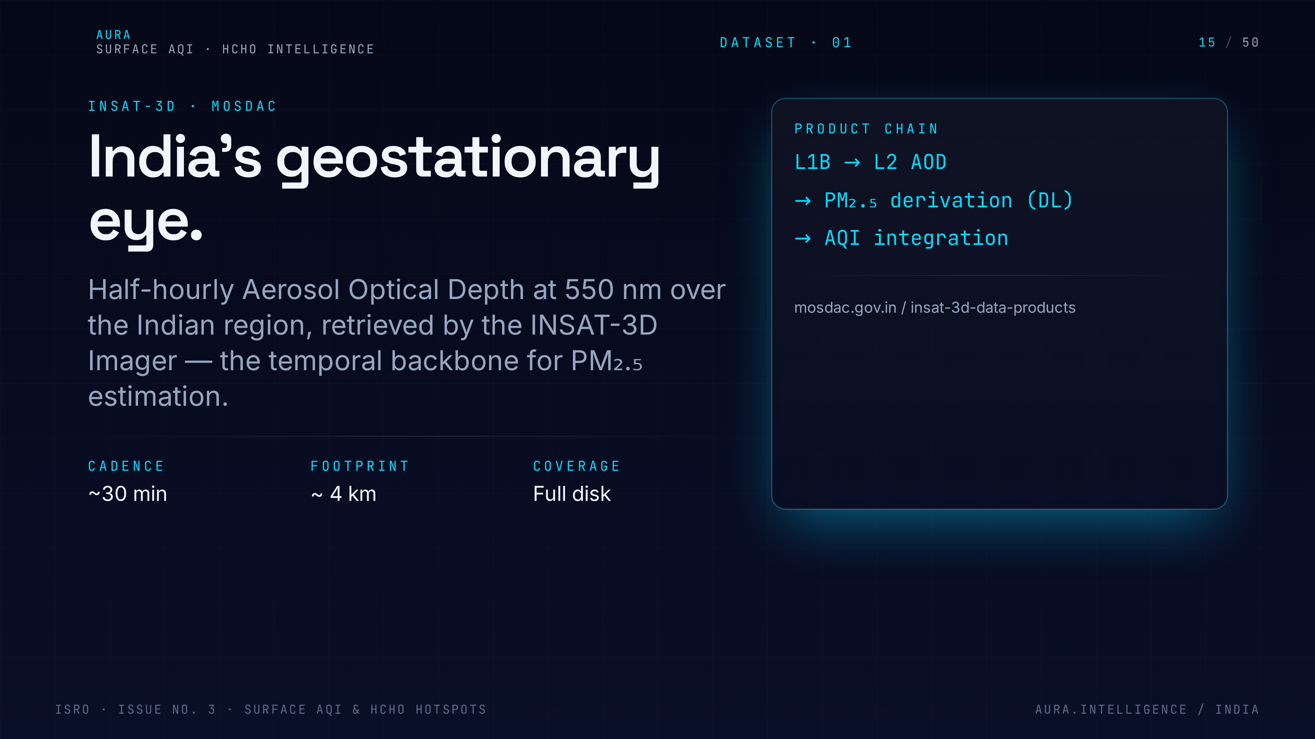
Notes:
15. INSAT-3D
INSAT-3D gives us India-centric geostationary AOD with high temporal cadence — critical for diurnal AQI variation that polar-orbiting sensors miss.

Slide 16
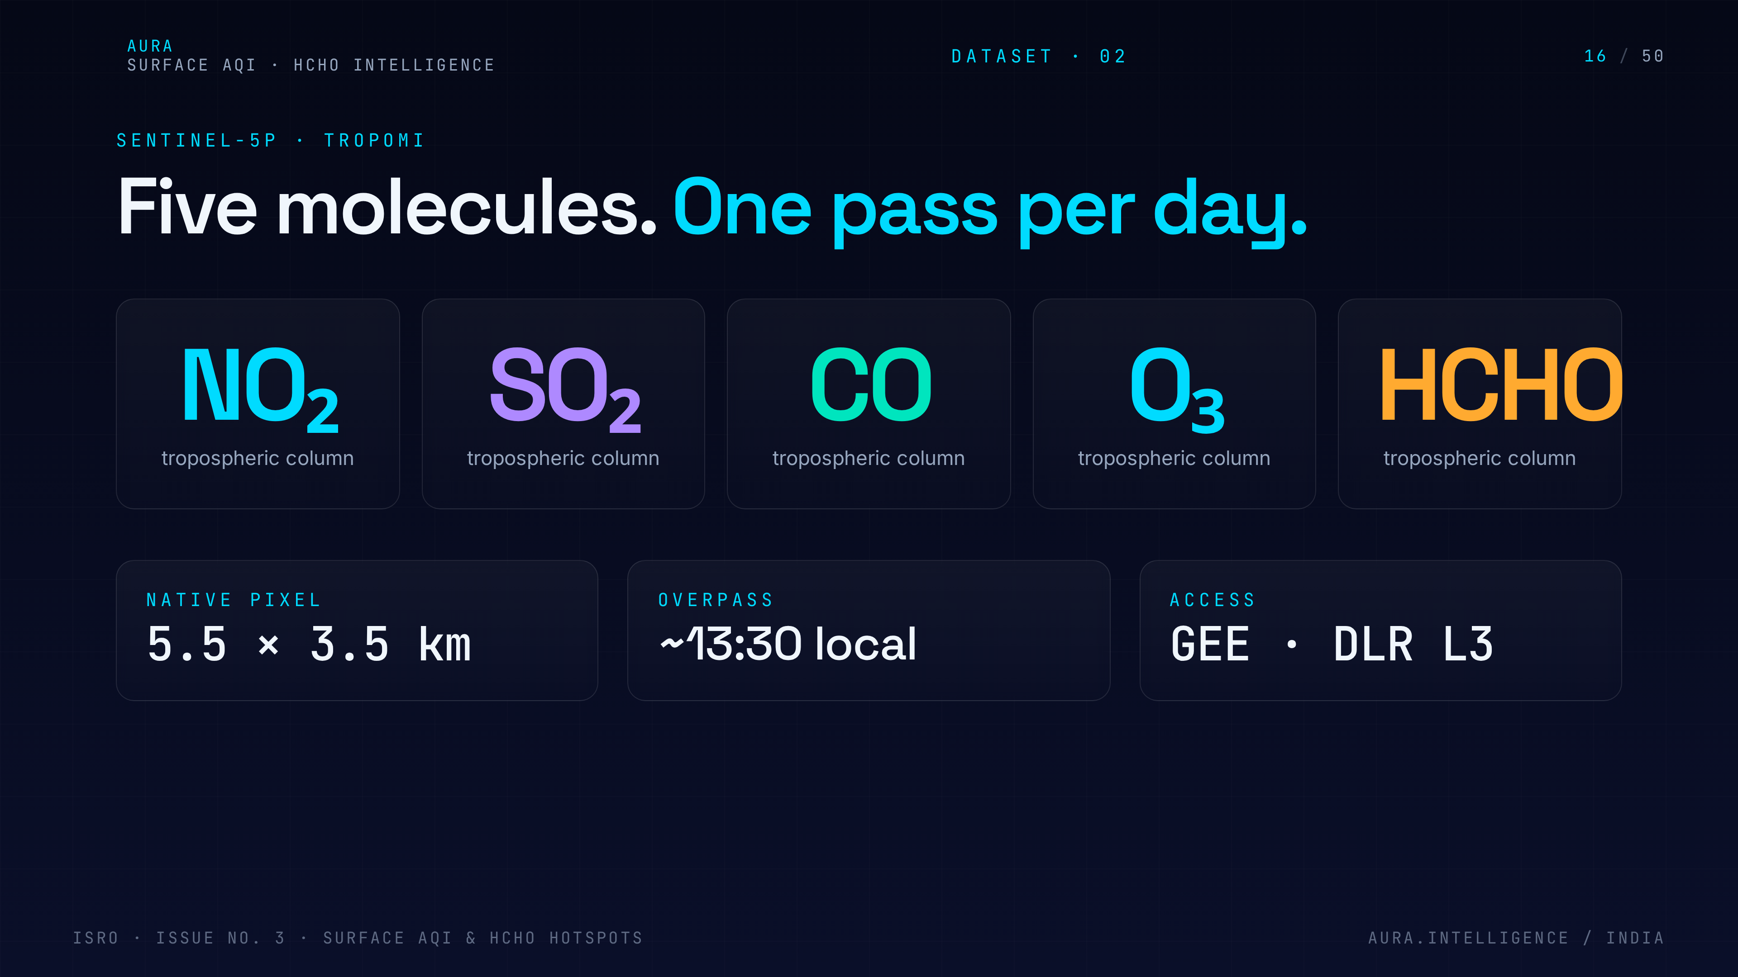
Notes:
16. Sentinel-5P TROPOMI
Sentinel-5P TROPOMI is our workhorse for trace gases: NO2, SO2, CO, HCHO at ~5.5 km. Daily global coverage, free, and the highest-resolution HCHO product available.

Slide 17
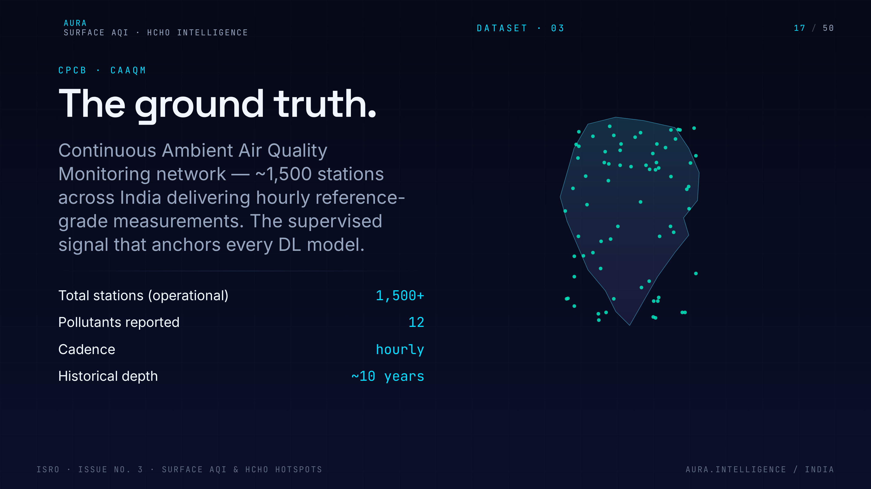
Notes:
17. CPCB ground truth
CPCB is the ground truth — about 500+ continuous stations. We use them to train and validate the column-to-surface model, and we are upfront about their urban bias.

Slide 18
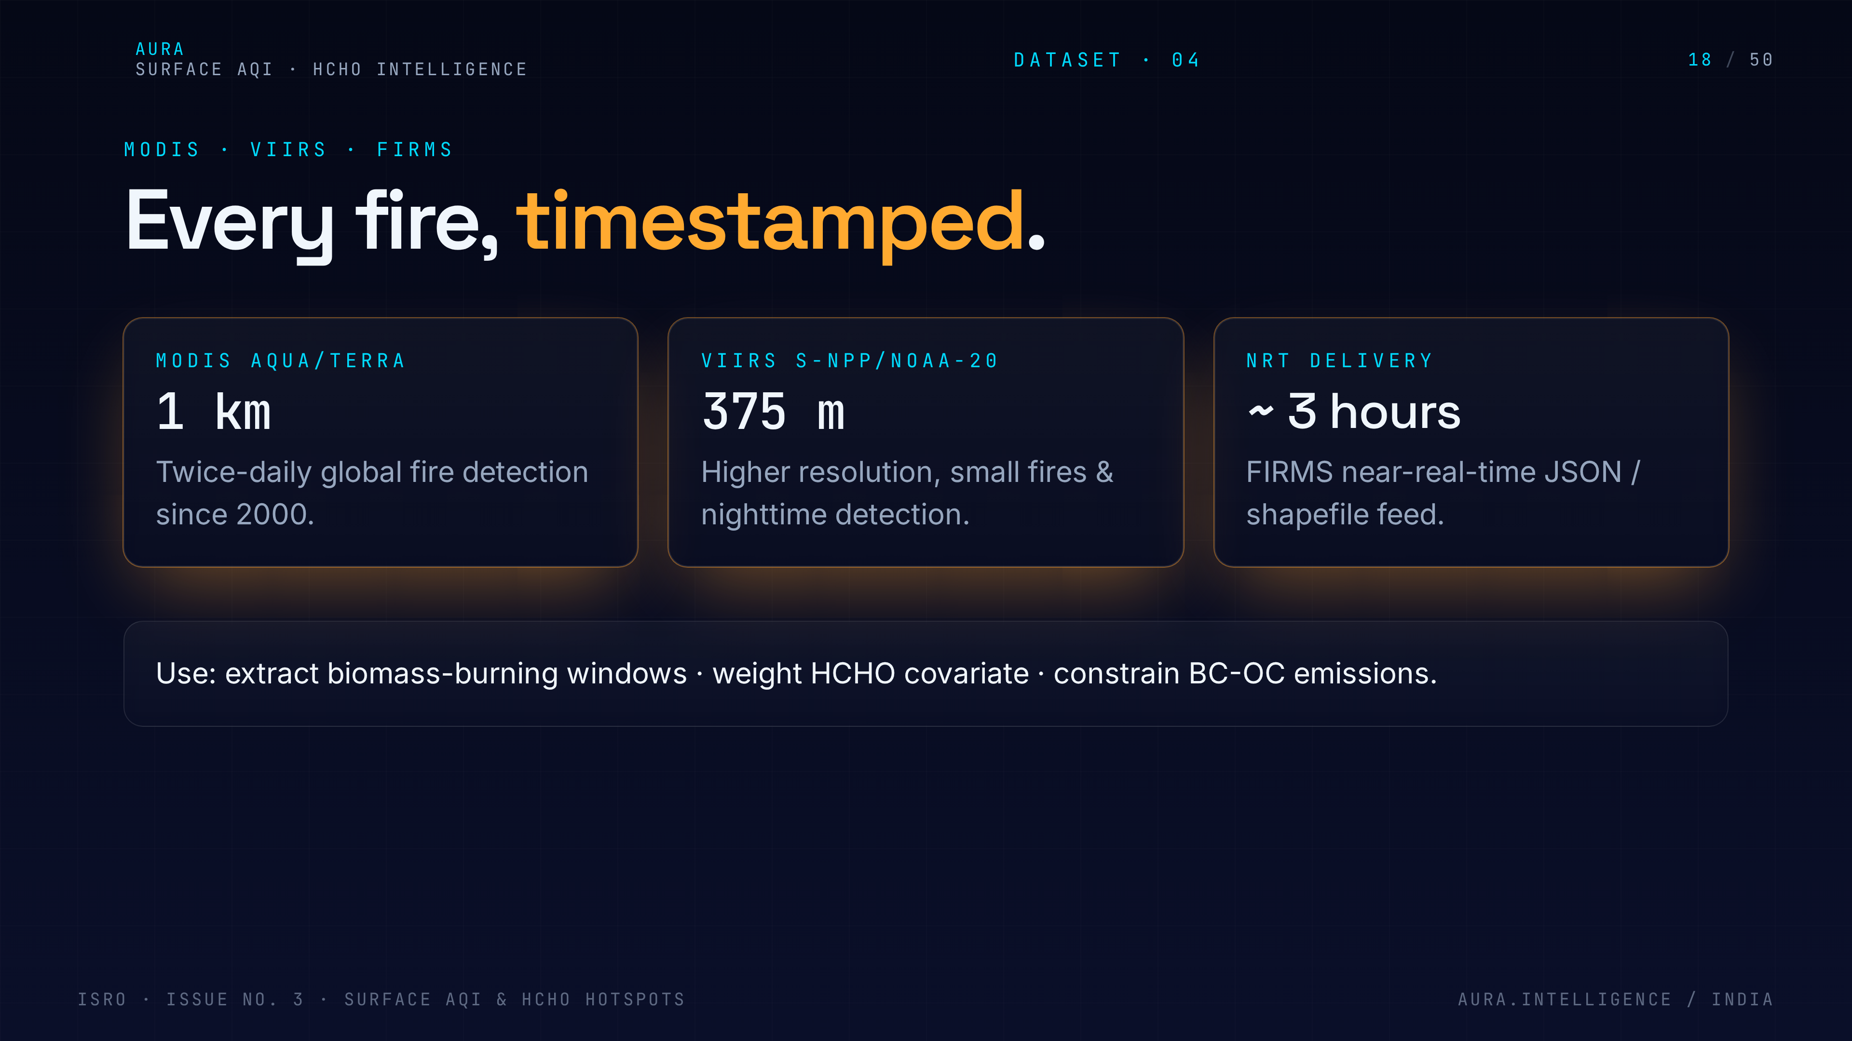
Notes:
18. MODIS / VIIRS fire
MODIS Terra/Aqua and VIIRS active fire products give us per-pixel fire detections every few hours. Essential for tying HCHO spikes to specific burning events.

Slide 19
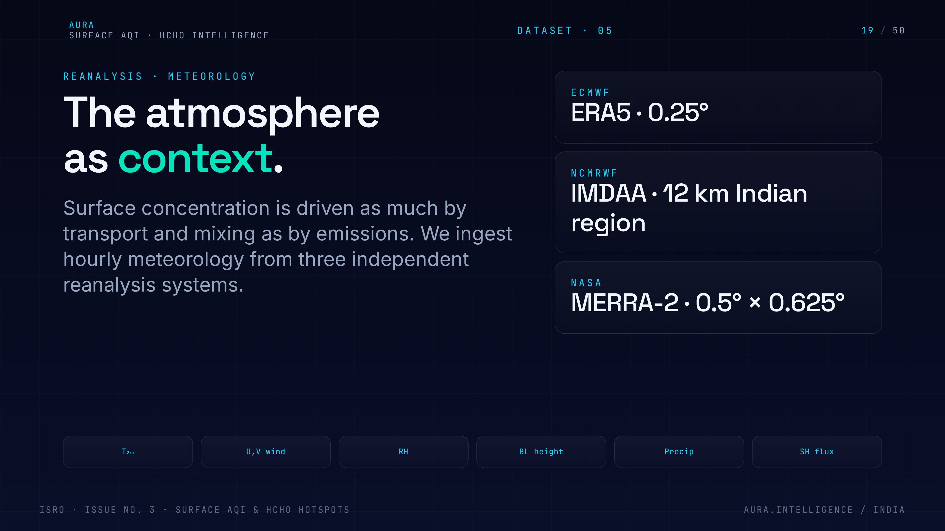
Notes:
19. Reanalysis meteorology
ERA5 reanalysis brings boundary layer height, wind, humidity and temperature. Without meteorology you cannot collapse a column measurement into a surface concentration.

Slide 20
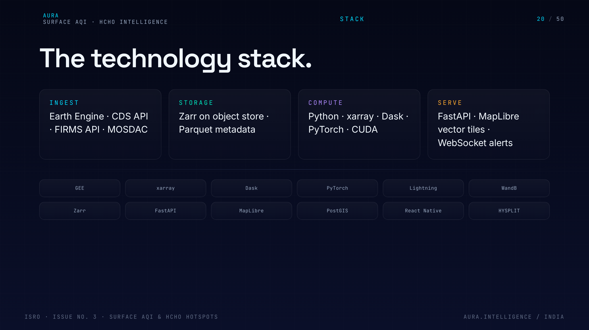
Notes:
20. Tech stack
Tech stack overview. Google Earth Engine for petabyte-scale ingestion, Python + PyTorch for modelling, FastAPI for serving, React Native for the mobile app. Standard, defensible choices.

Slide 21
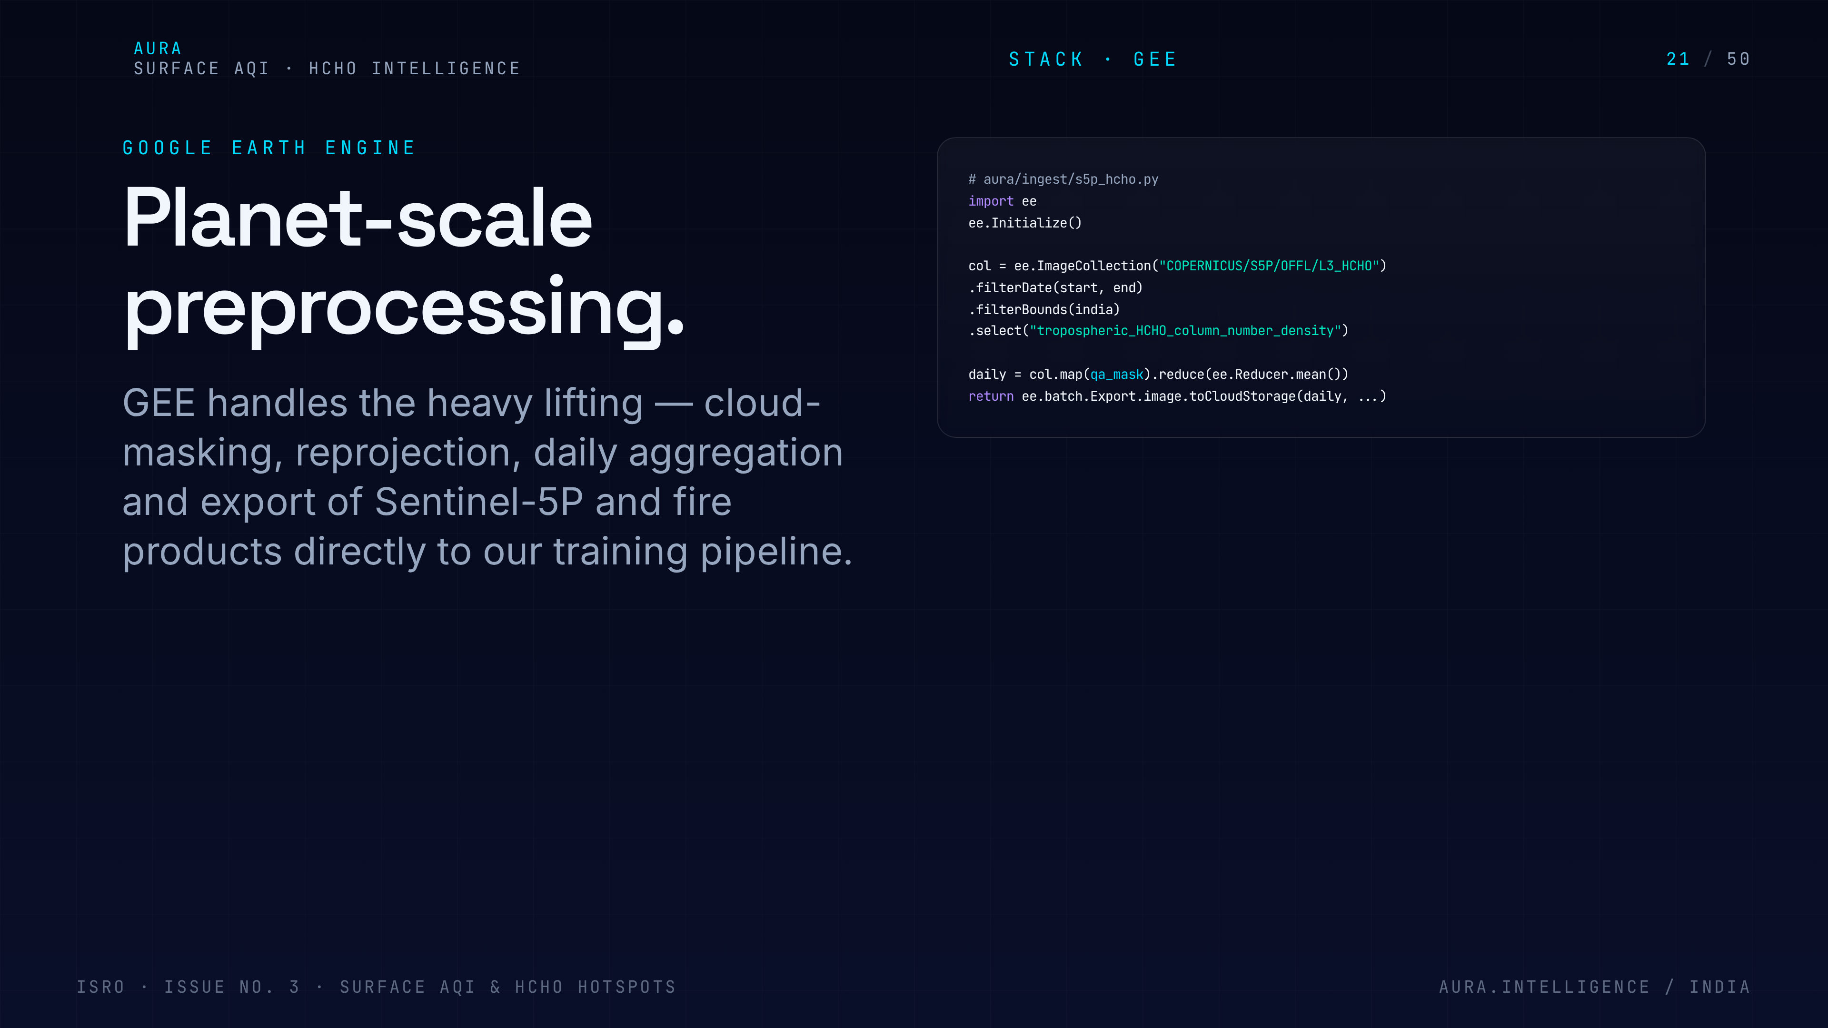
Notes:
21. Google Earth Engine
Why GEE: we never download the satellite archive. We push the computation to the data, which is the only way to process daily India-wide rasters in our timeline.

Slide 22
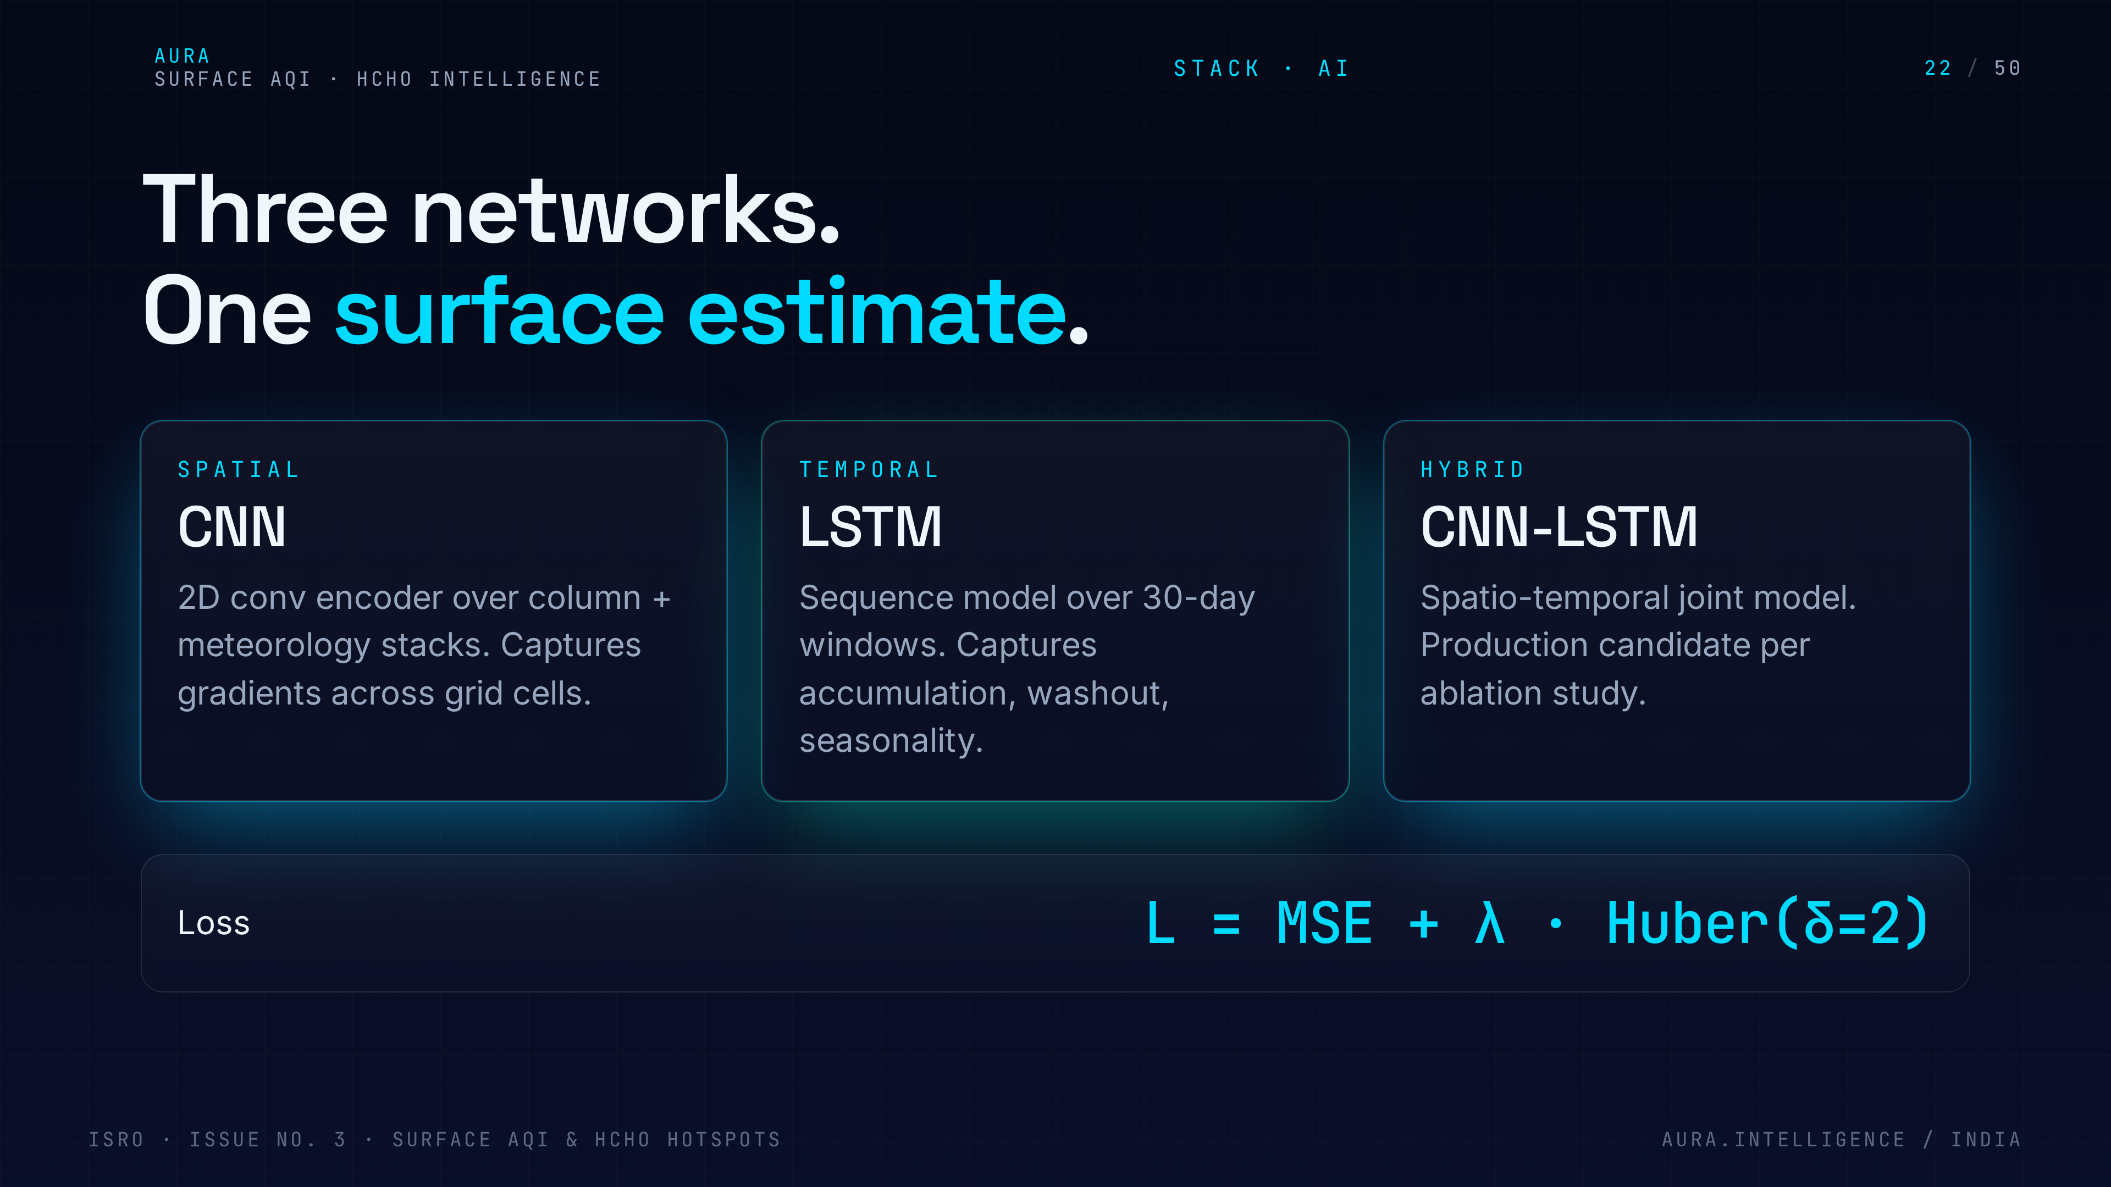
Notes:
22. Deep learning models
Deep learning rationale. CNN captures spatial structure of the satellite image; LSTM captures the time dependence of pollution. DBSCAN handles the unsupervised hotspot clustering for HCHO.

Slide 23
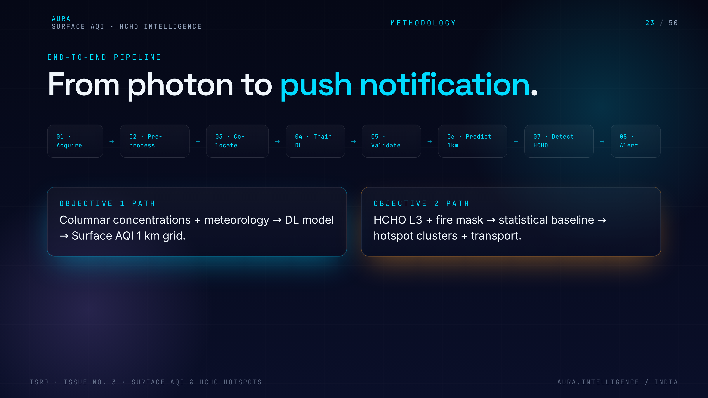
Notes:
23. End-to-end pipeline
End-to-end pipeline view — ingestion, harmonisation, modelling, validation, serving. Use this as a map for the next ten slides.

Slide 24
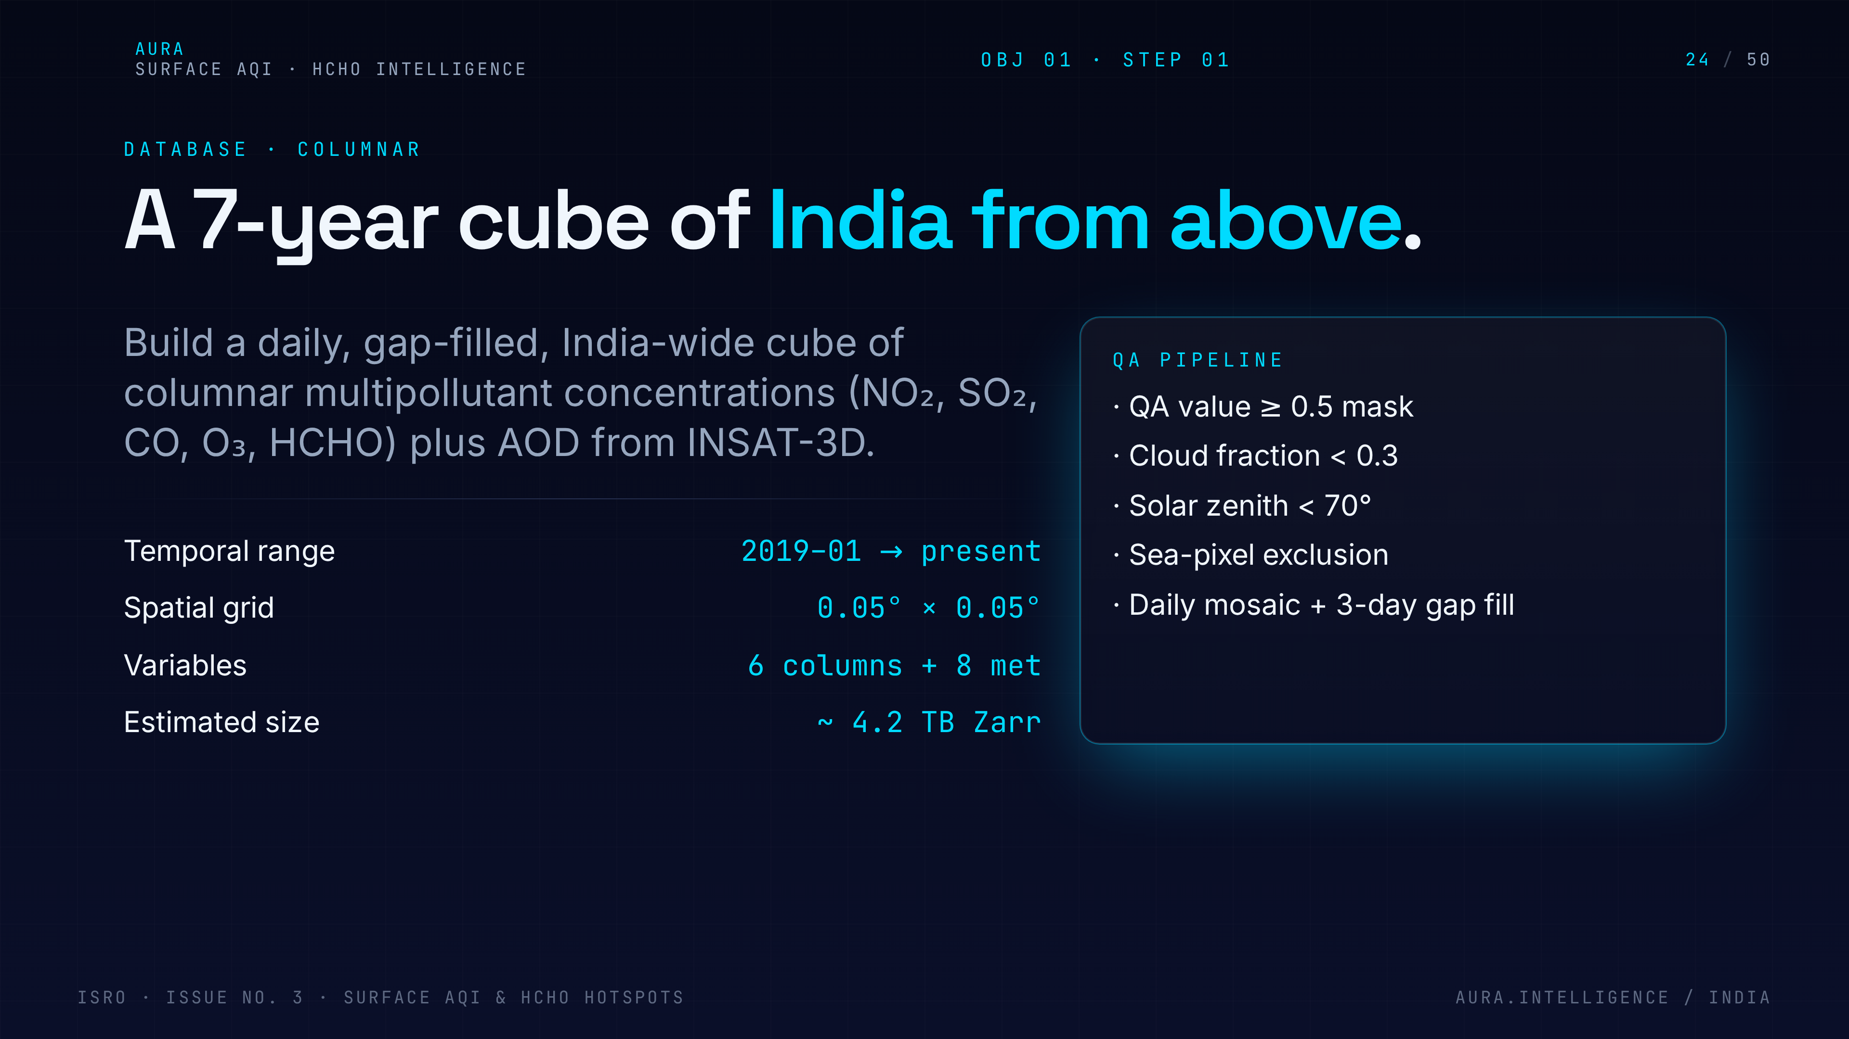
Notes:
24. Columnar database
Objective 1 step one — build the columnar database. Harmonise TROPOMI, INSAT-3D and ERA5 onto a common 1 km India grid, cloud-masked and quality-filtered.

Slide 25
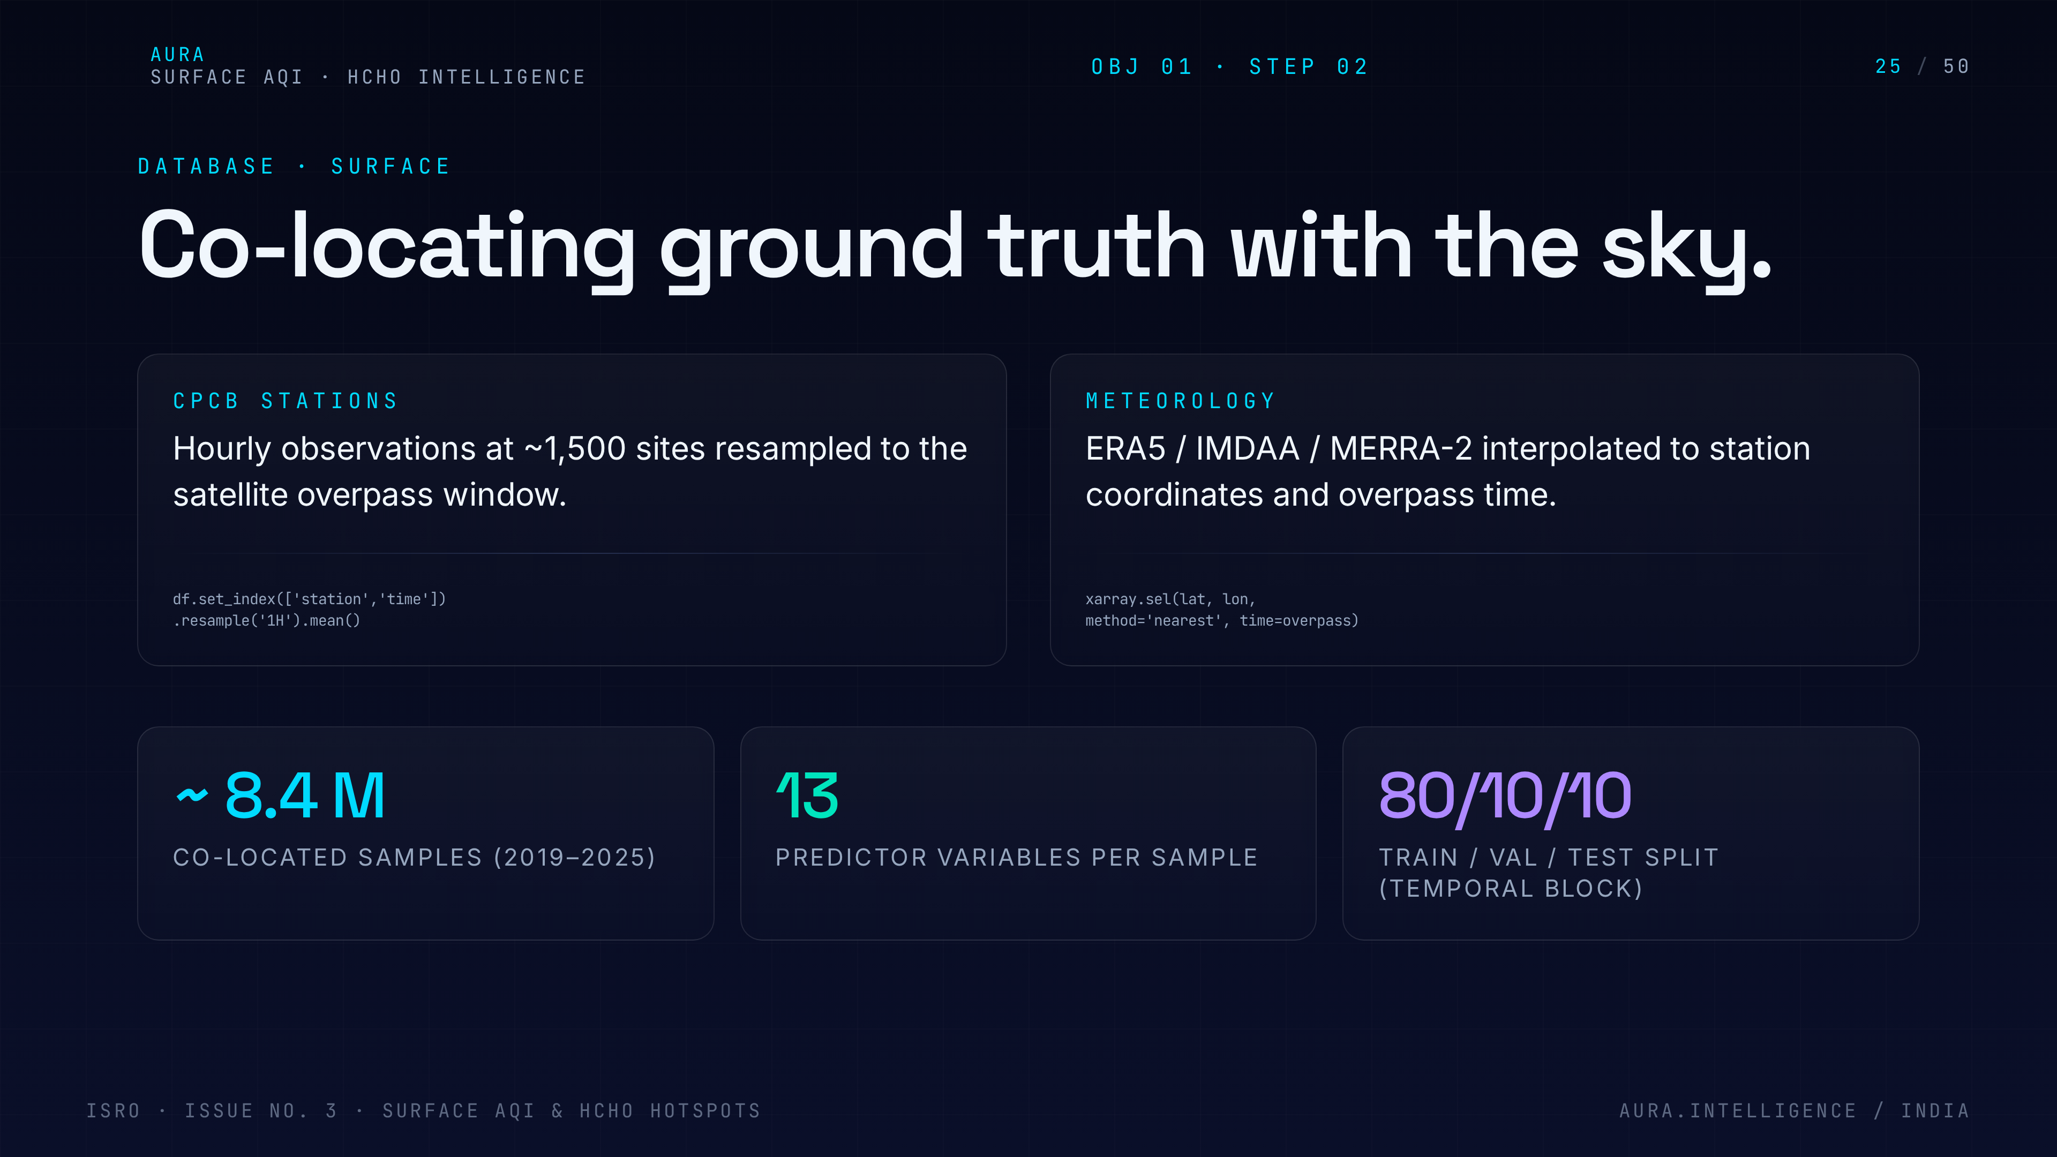
Notes:
25. Surface database
Step two — build the surface database. Co-locate CPCB station readings with the gridded columnar stack to create the supervised learning pairs.

Slide 26
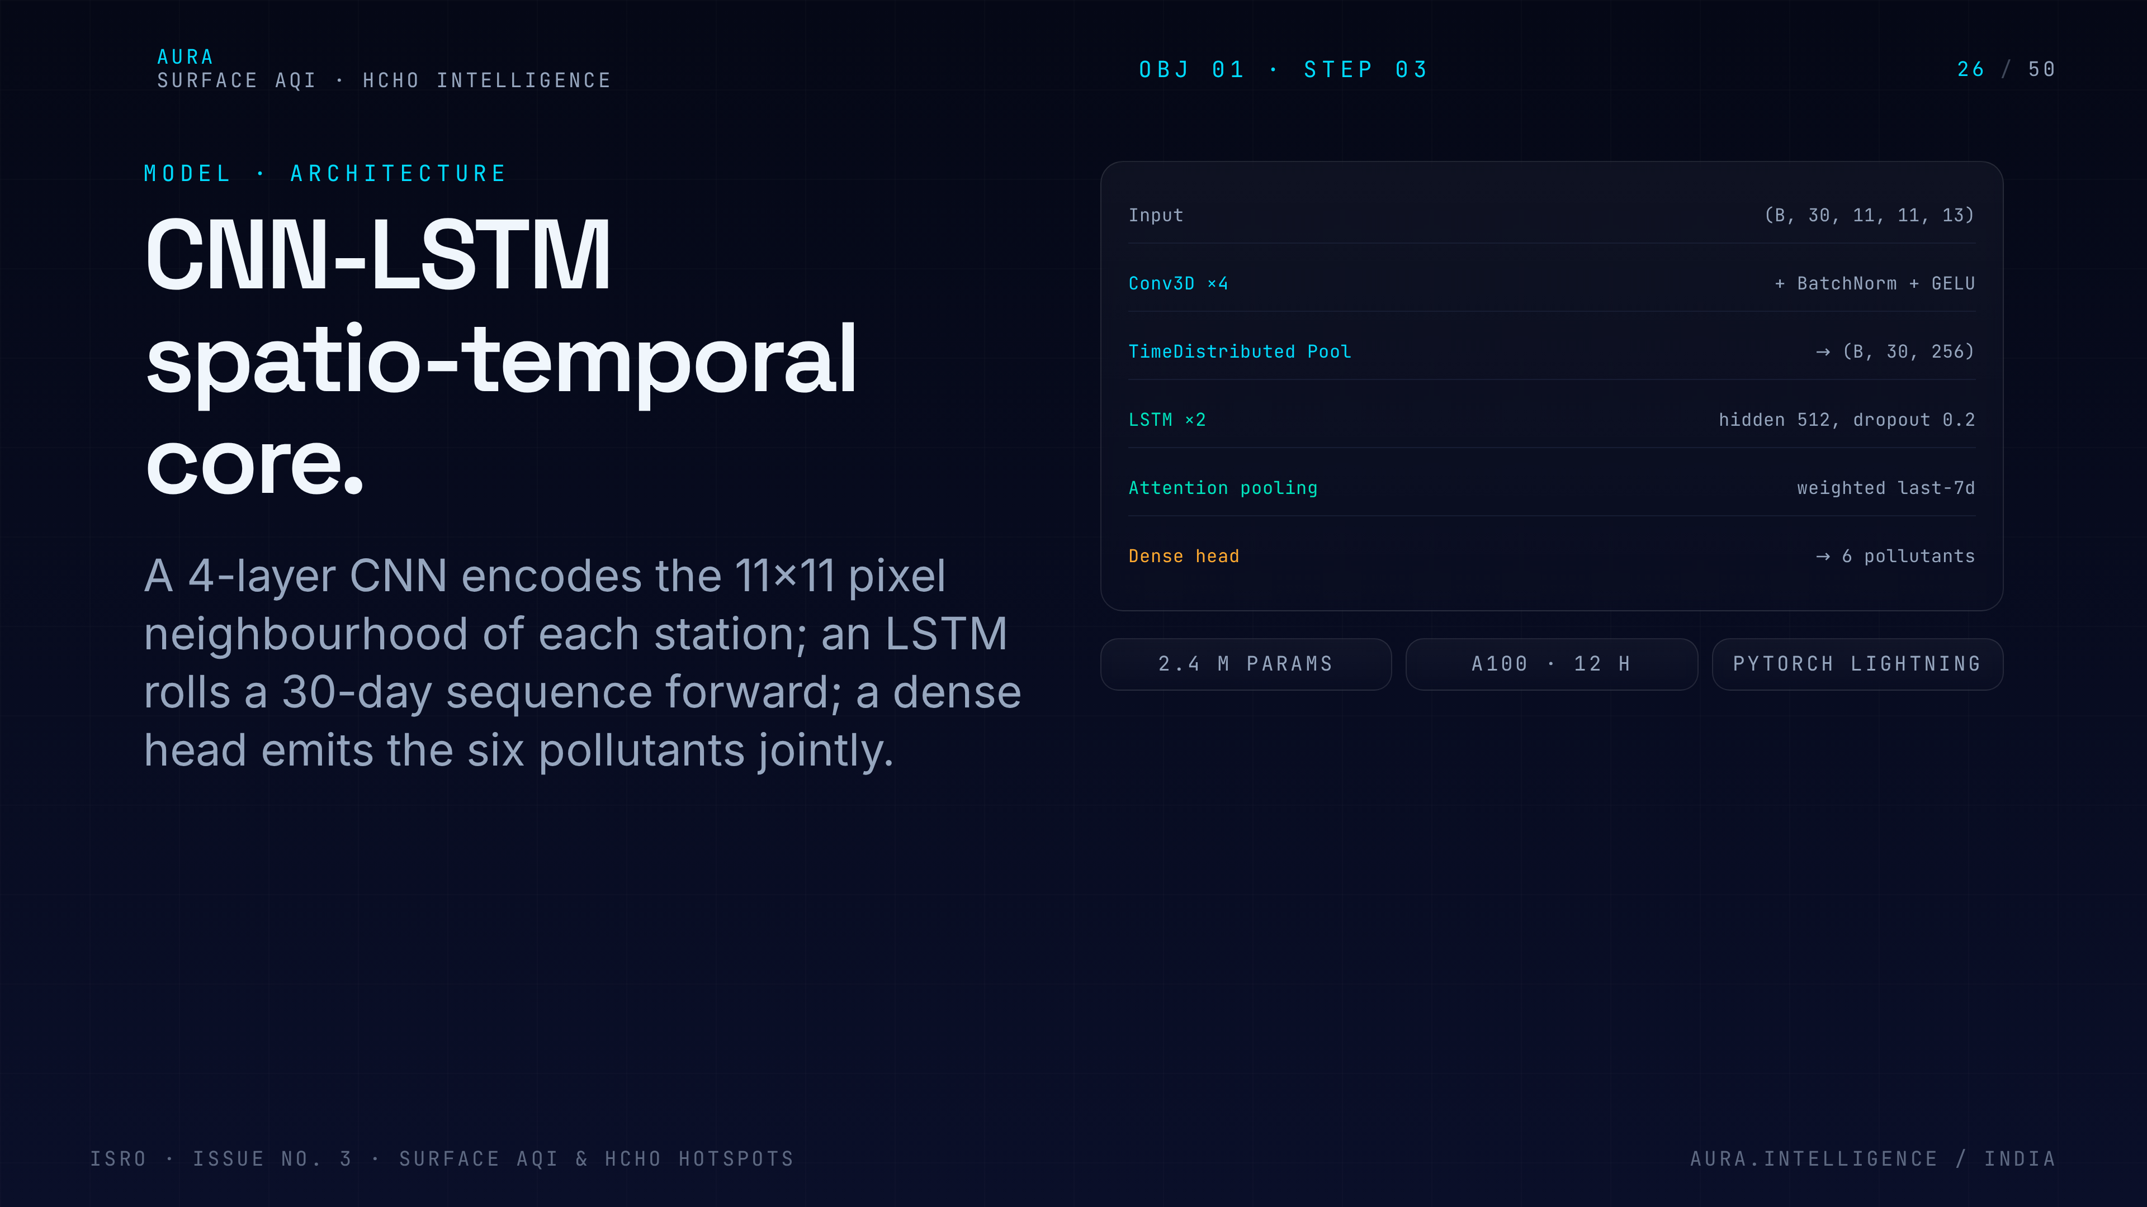
Notes:
26. CNN-LSTM architecture
Architecture deep-dive. A CNN encoder reads the 1 km column + met patch, an LSTM head reads the prior 24 hours, and the regression head outputs PM2.5/PM10/NO2/SO2/O3 at the surface.

Slide 27
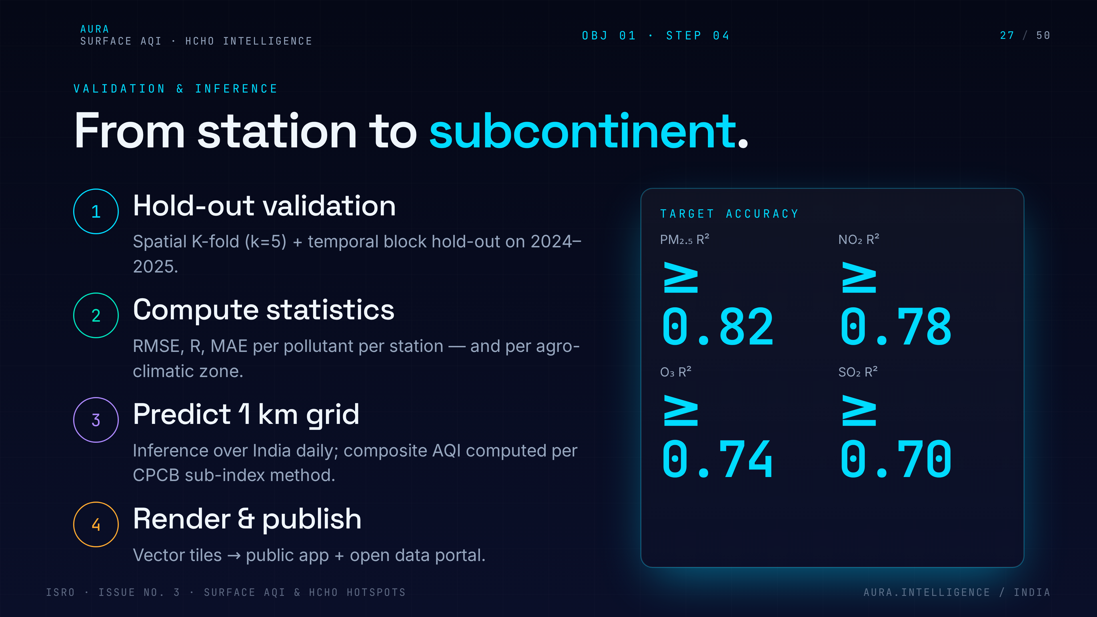
Notes:
27. Validation & inference
Validation plan — spatial K-fold by city, temporal hold-out by season, target R-squared above 0.75 against CPCB. Then daily inference on Earth Engine pushes maps to the API.

Slide 28
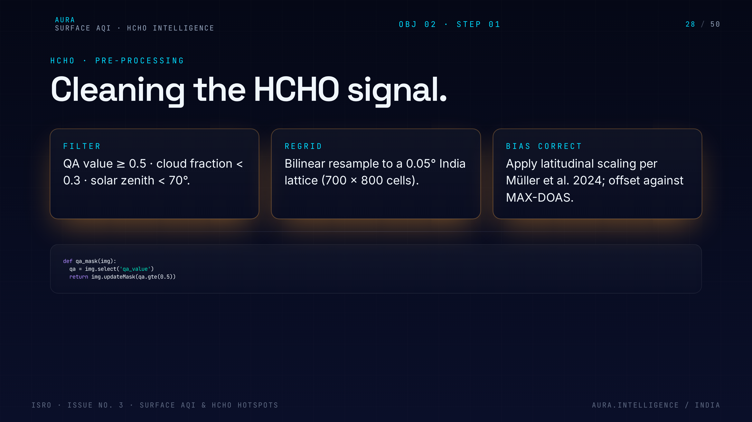
Notes:
28. HCHO pre-processing
Objective 2 starts with HCHO pre-processing — quality flag filtering, cloud fraction below 0.3, bias correction against ground campaigns. Garbage in, hotspots out.

Slide 29
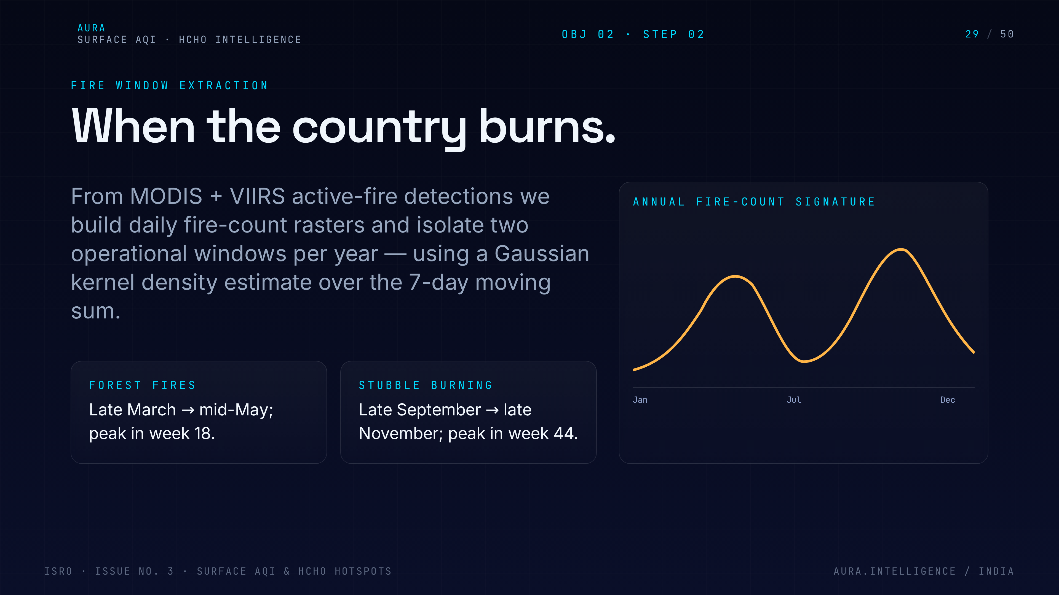
Notes:
29. Fire window extraction
Fire-window extraction. We slice the time series around the two burning seasons so the clustering algorithm sees the events, not the annual mean.

Slide 30
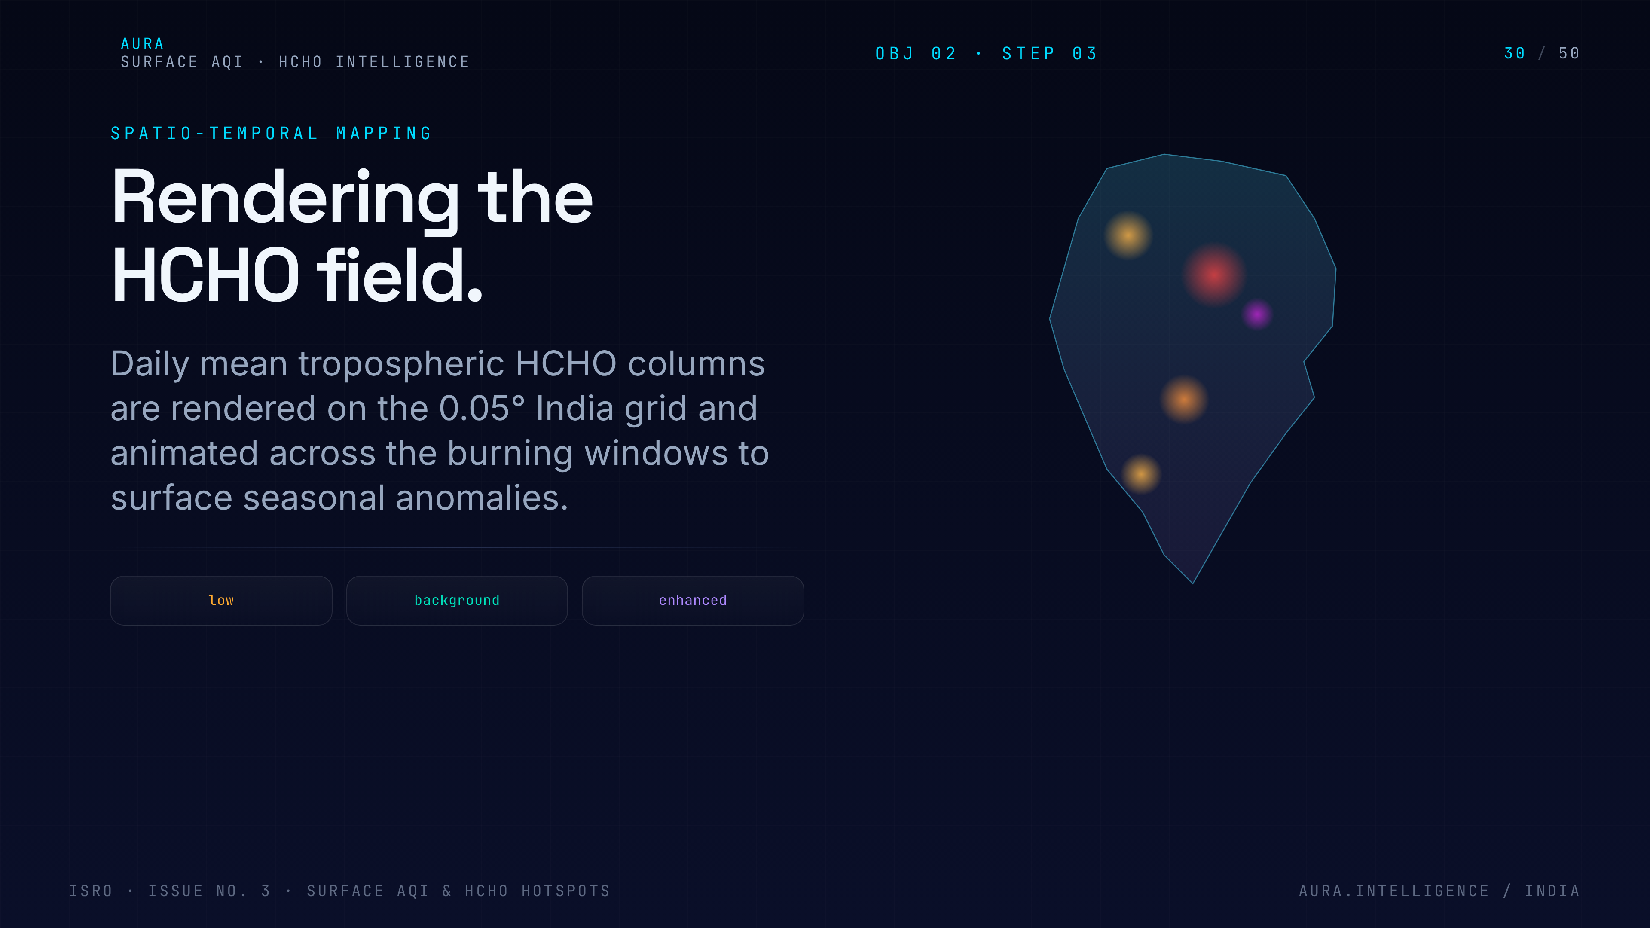
Notes:
30. Spatio-temporal mapping
Spatio-temporal mapping — voxelise India into 0.05° x daily cells, normalise HCHO anomalies against a five-year climatology to suppress background.

Slide 31
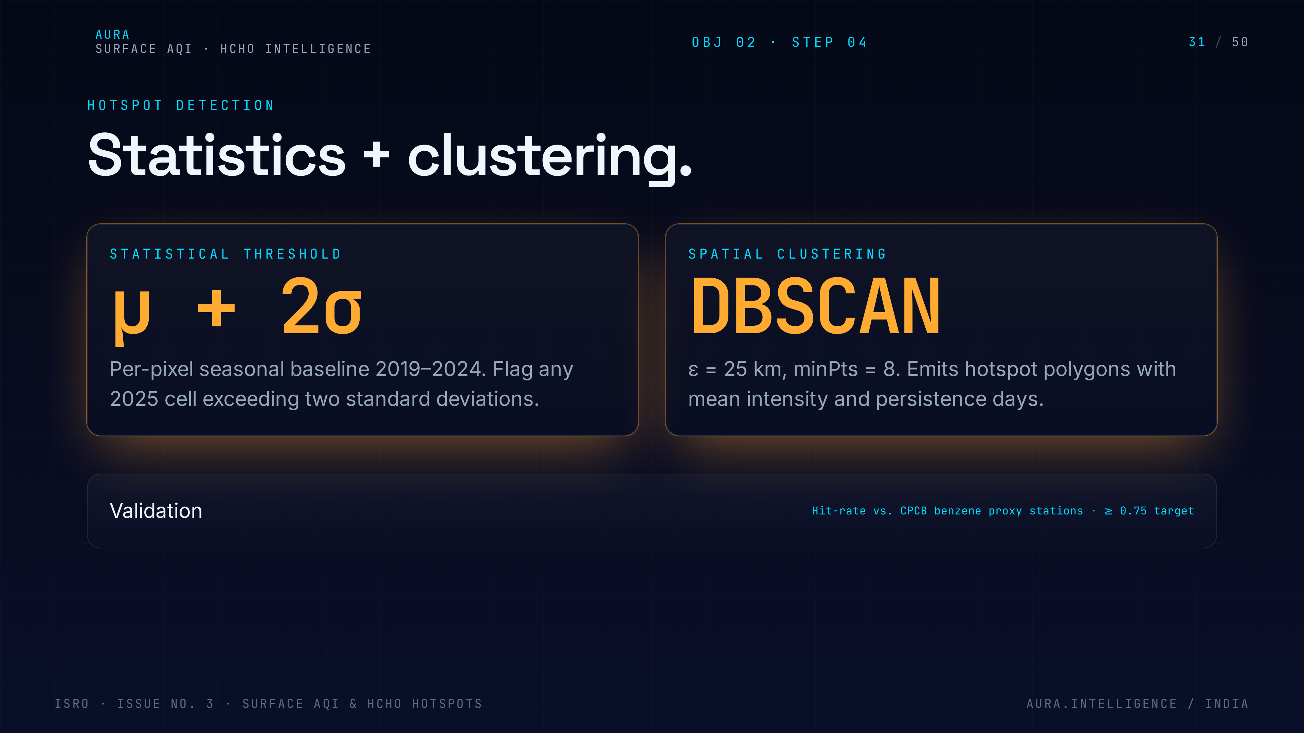
Notes:
31. Hotspot detection
Hotspot detection with DBSCAN on the anomaly cube. Density-based clustering finds organic shapes — plumes, industrial belts — without us pre-specifying how many hotspots exist.

Slide 32
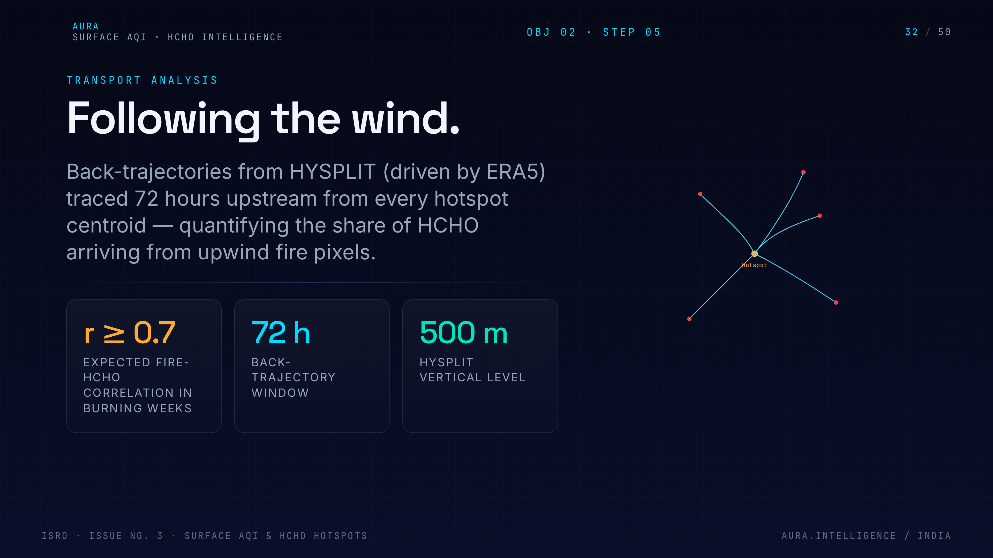
Notes:
32. Transport analysis
Transport analysis. For each hotspot, back-trajectory using HYSPLIT + ERA5 winds tells us where the air came from, closing the loop on source attribution.

Slide 33
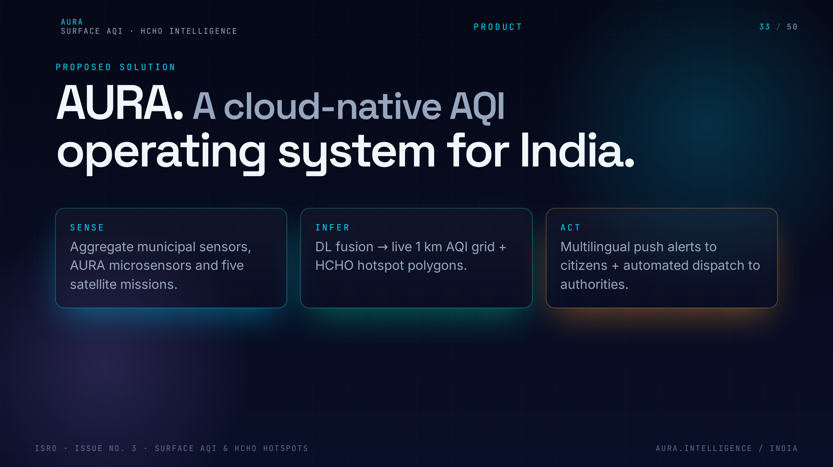
Notes:
33. Solution overview
Pivot to the product. Three lenses on the same data: urban dashboards, rural mesh, and forest/extreme-rural coverage. One platform, three user experiences.

Slide 34
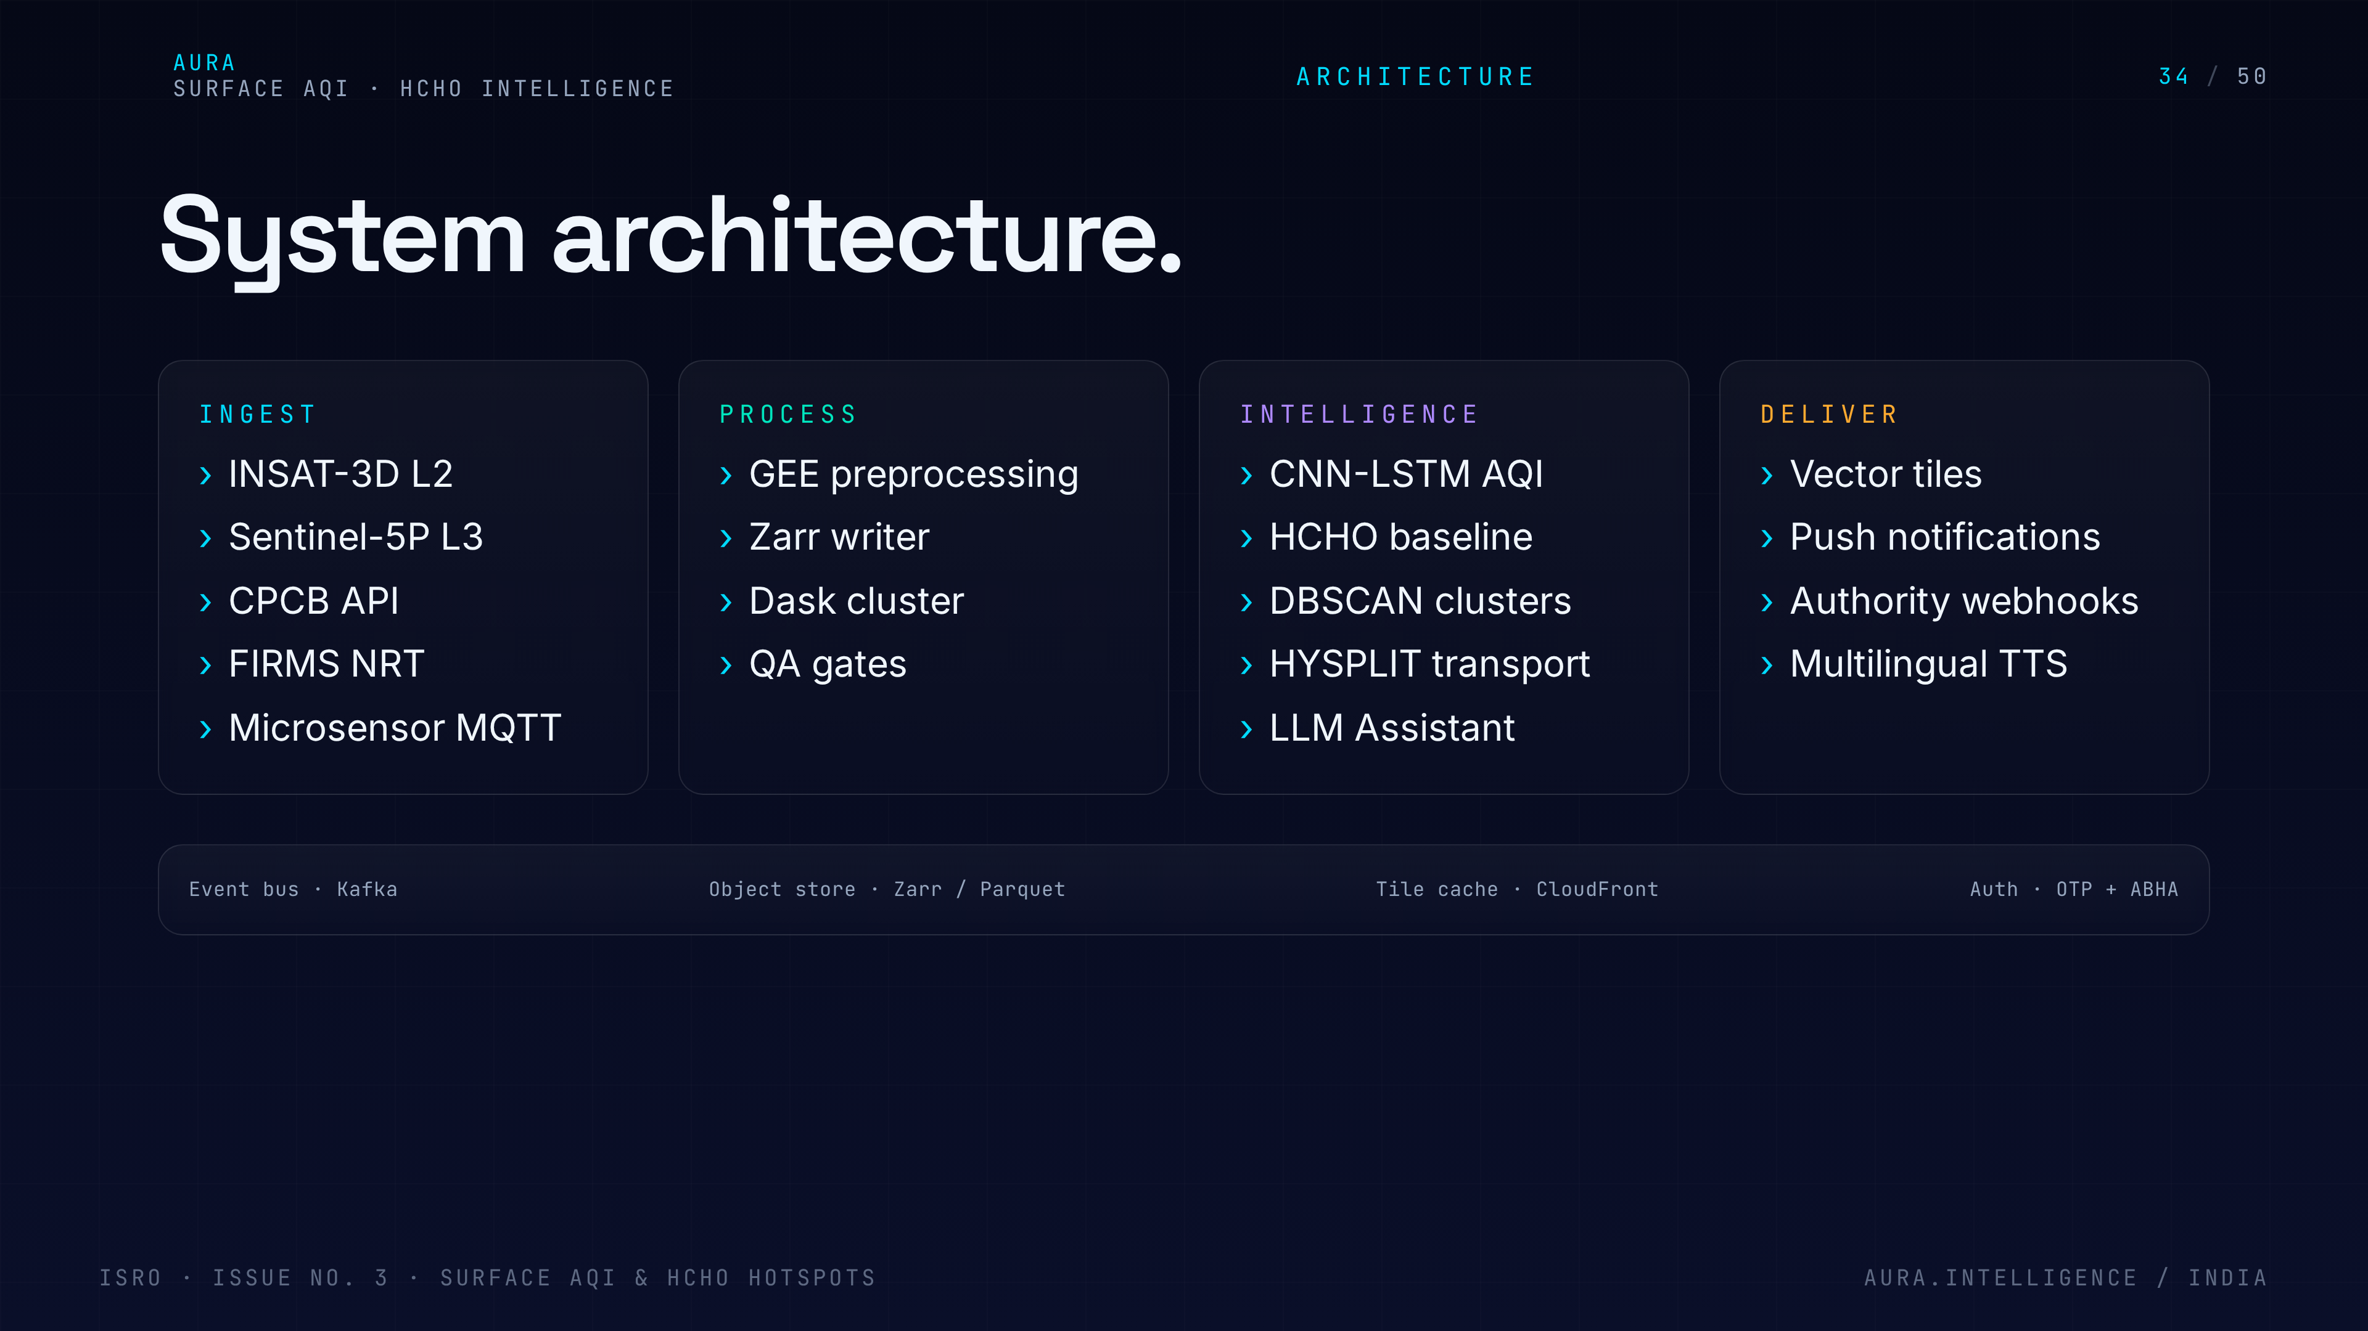
Notes:
34. System architecture
System architecture — Earth Engine + microsensor ingestion, model serving on GPU pods, API gateway, mobile + web clients, authority dispatch webhook. Show the boxes and arrows.

Slide 35
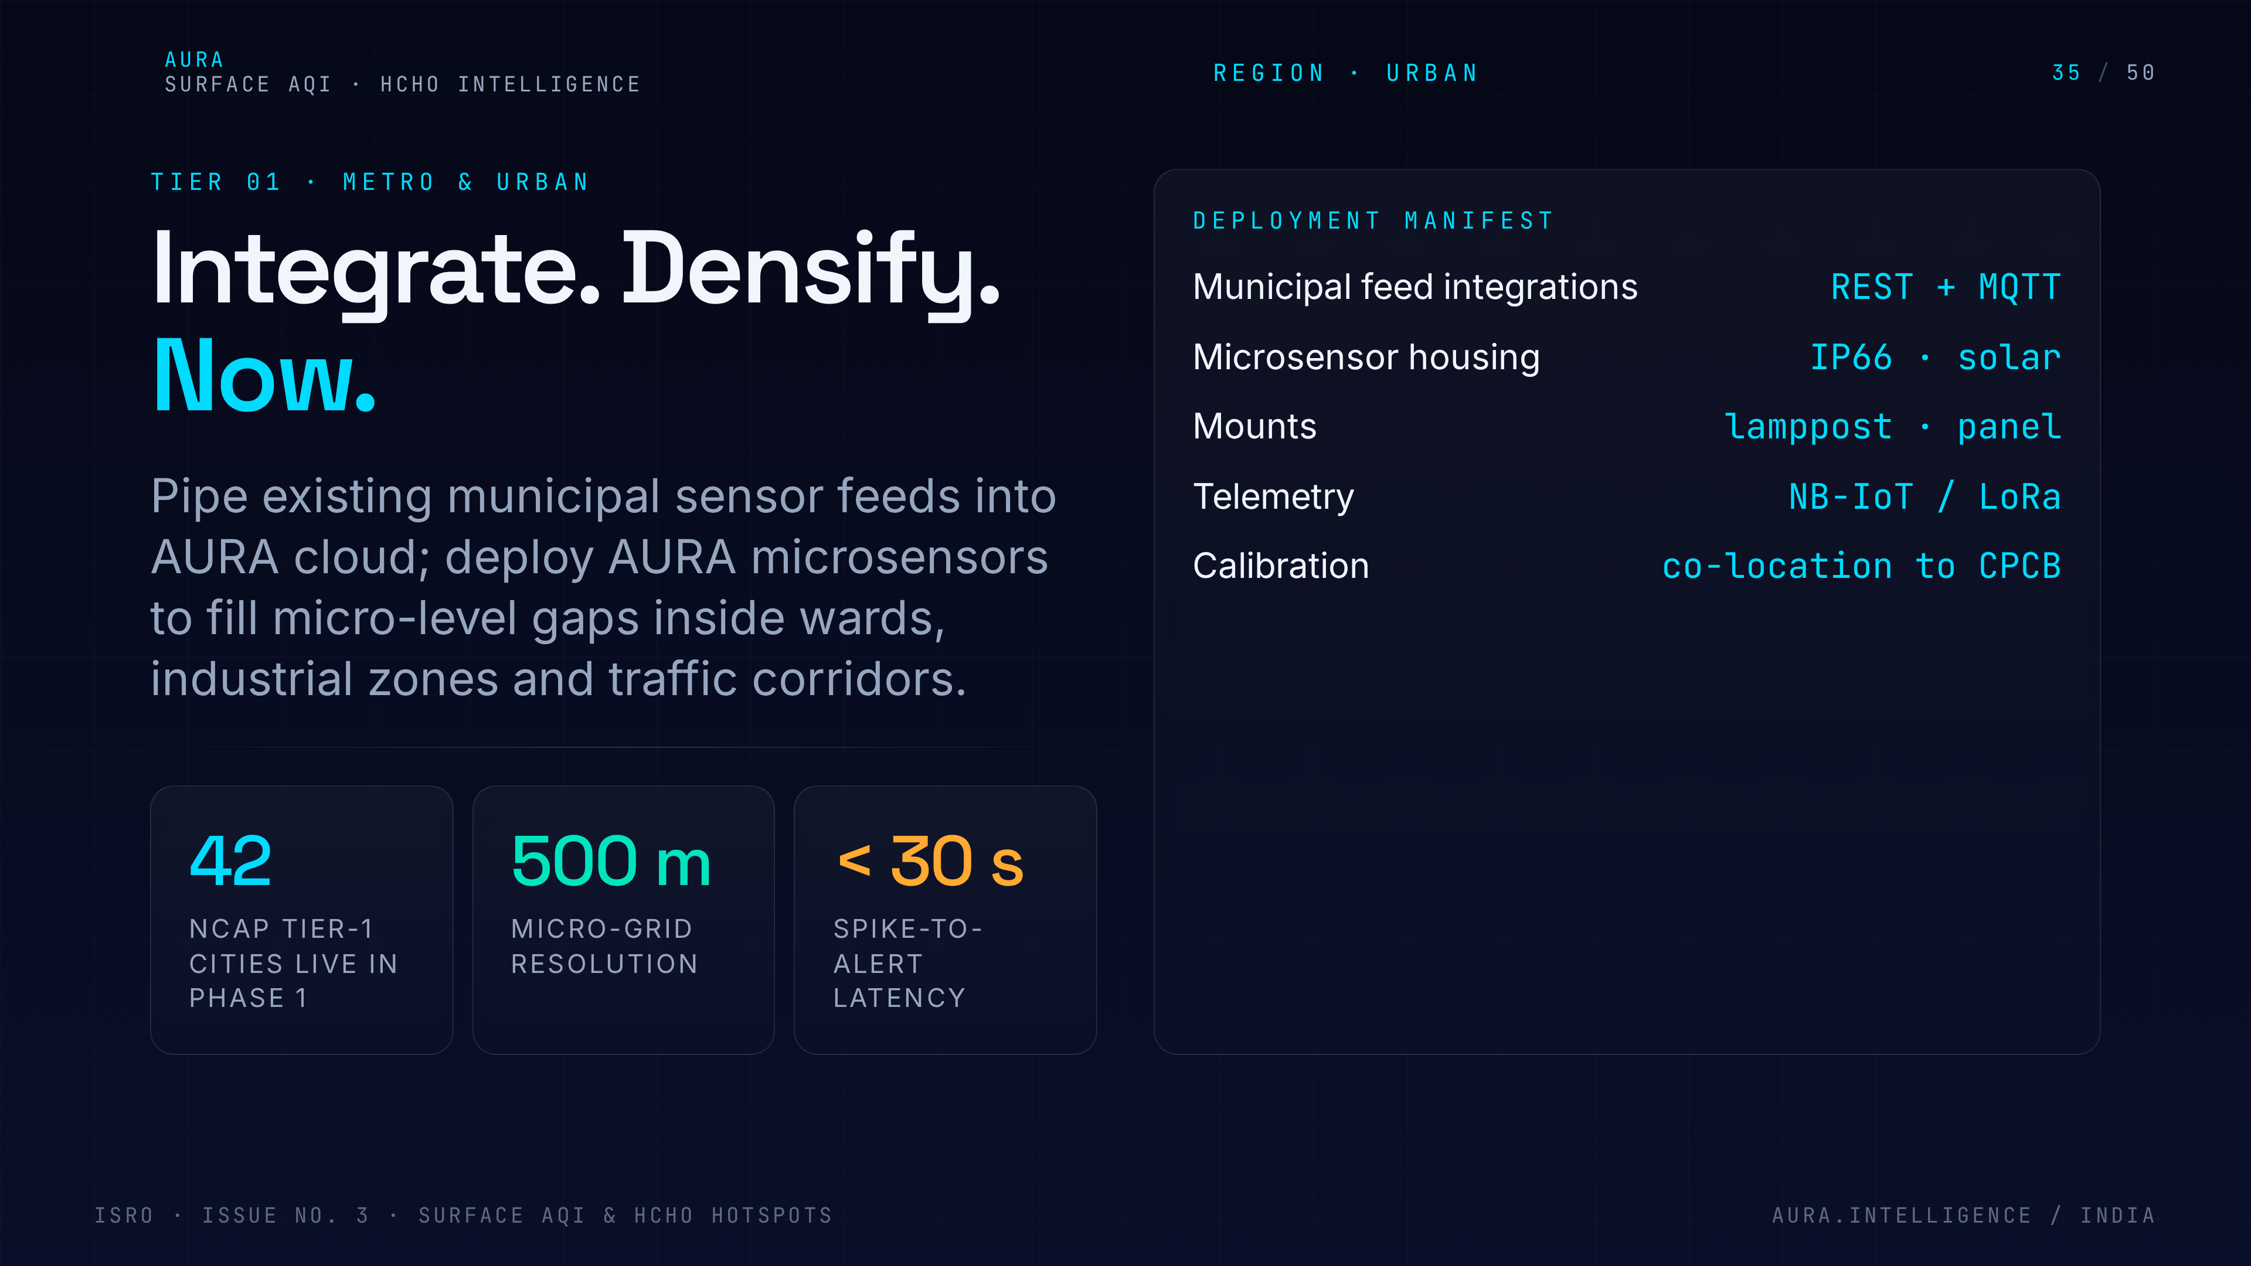
Notes:
35. Urban tier
Urban tier. In Tier-1 cities we fuse CPCB, satellite and traffic data into hyperlocal AQI down to the neighbourhood. This is what citizens see in their morning notification.

Slide 36
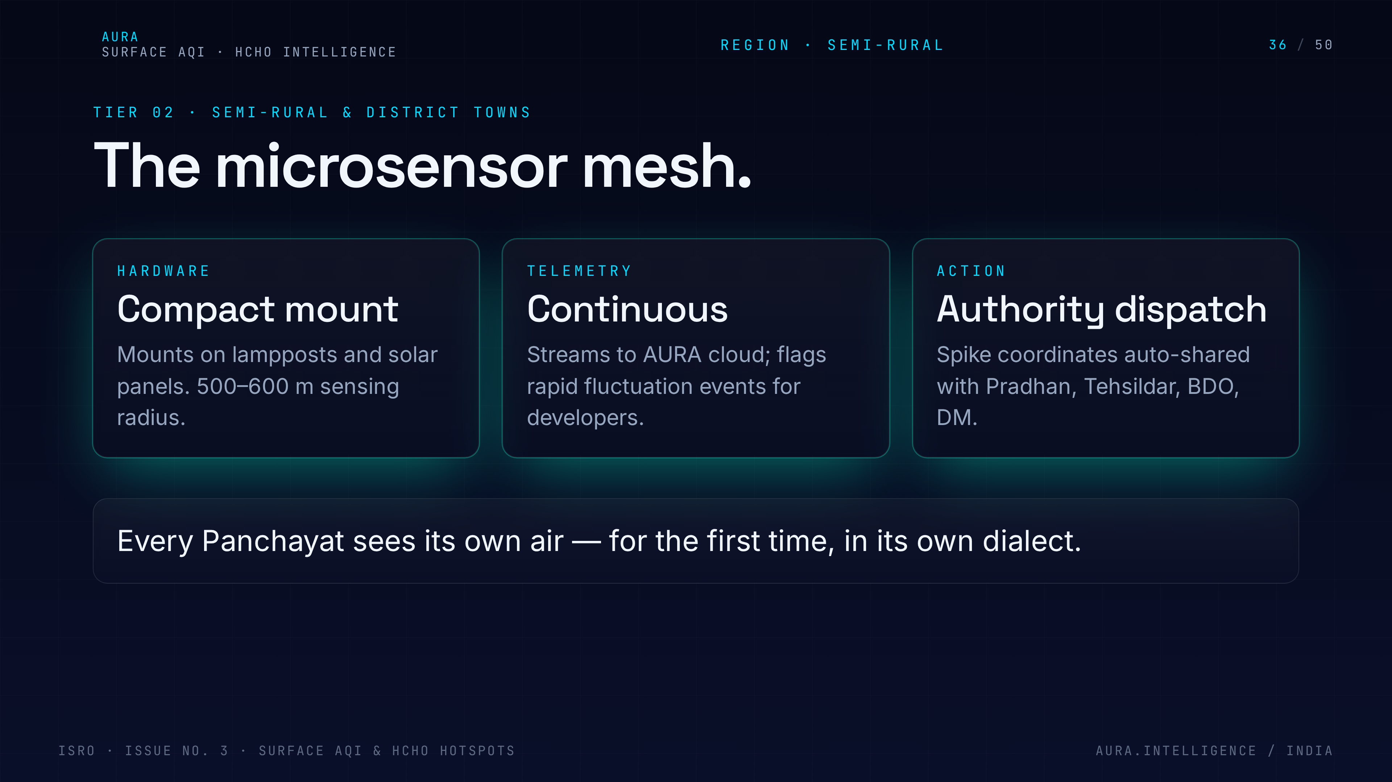
Notes:
36. Semi-rural microsensor mesh
Semi-rural tier. We propose a mesh of low-cost microsensors at panchayat offices and schools, calibrated against the satellite model. Coverage where CPCB will never go.

Slide 37
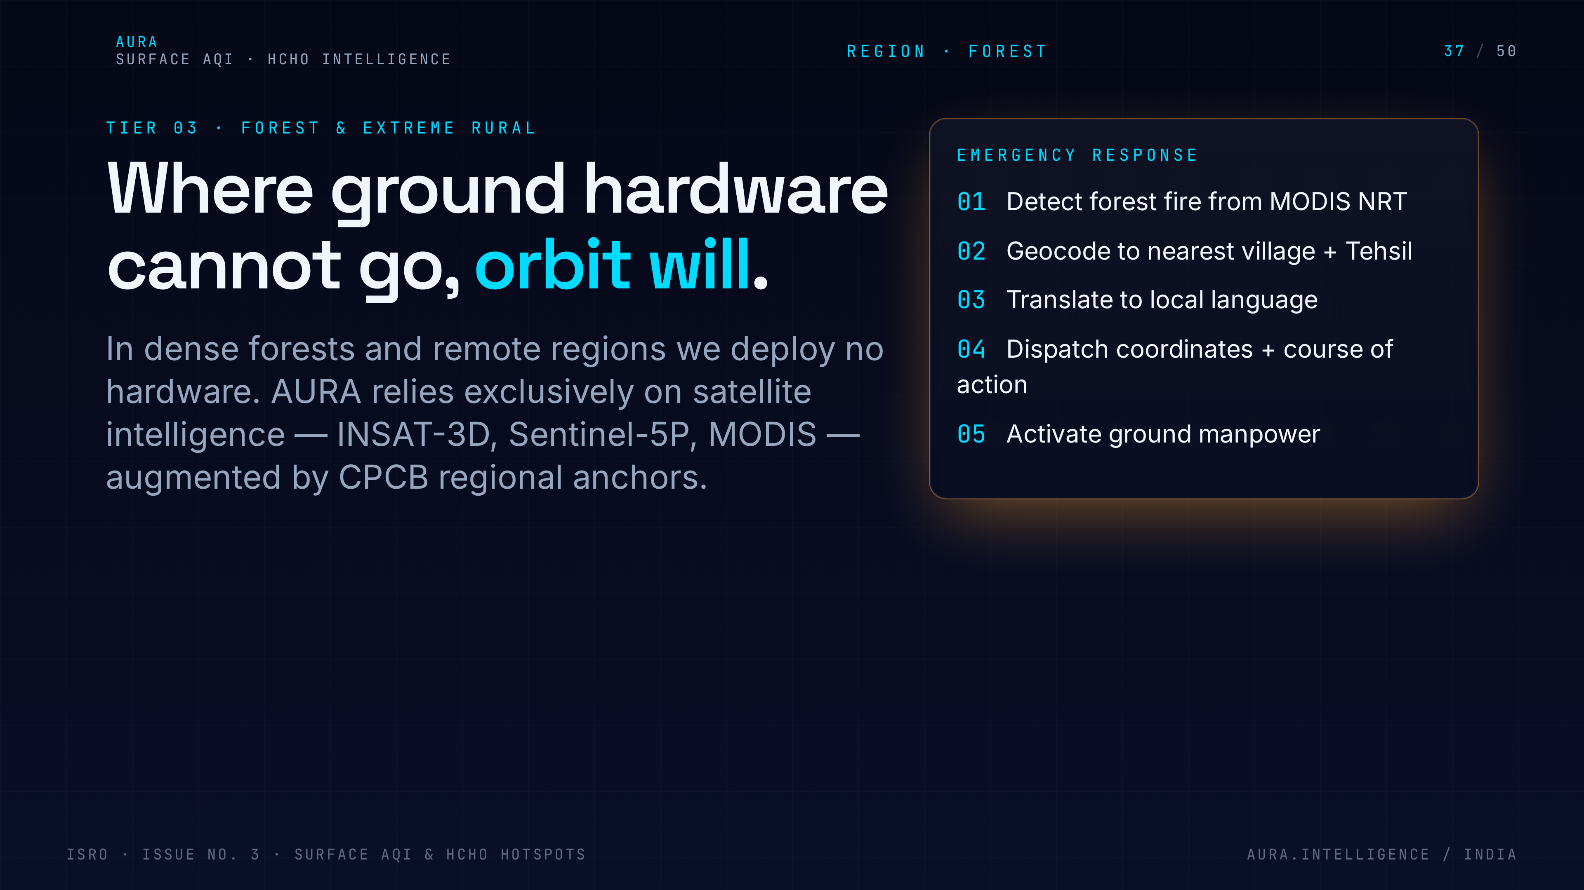
Notes:
37. Forest & extreme rural
Forest and extreme rural tier. Pure satellite-driven, with SMS and IVR fallback for users without smartphones. No Indian is invisible to the system.

Slide 38
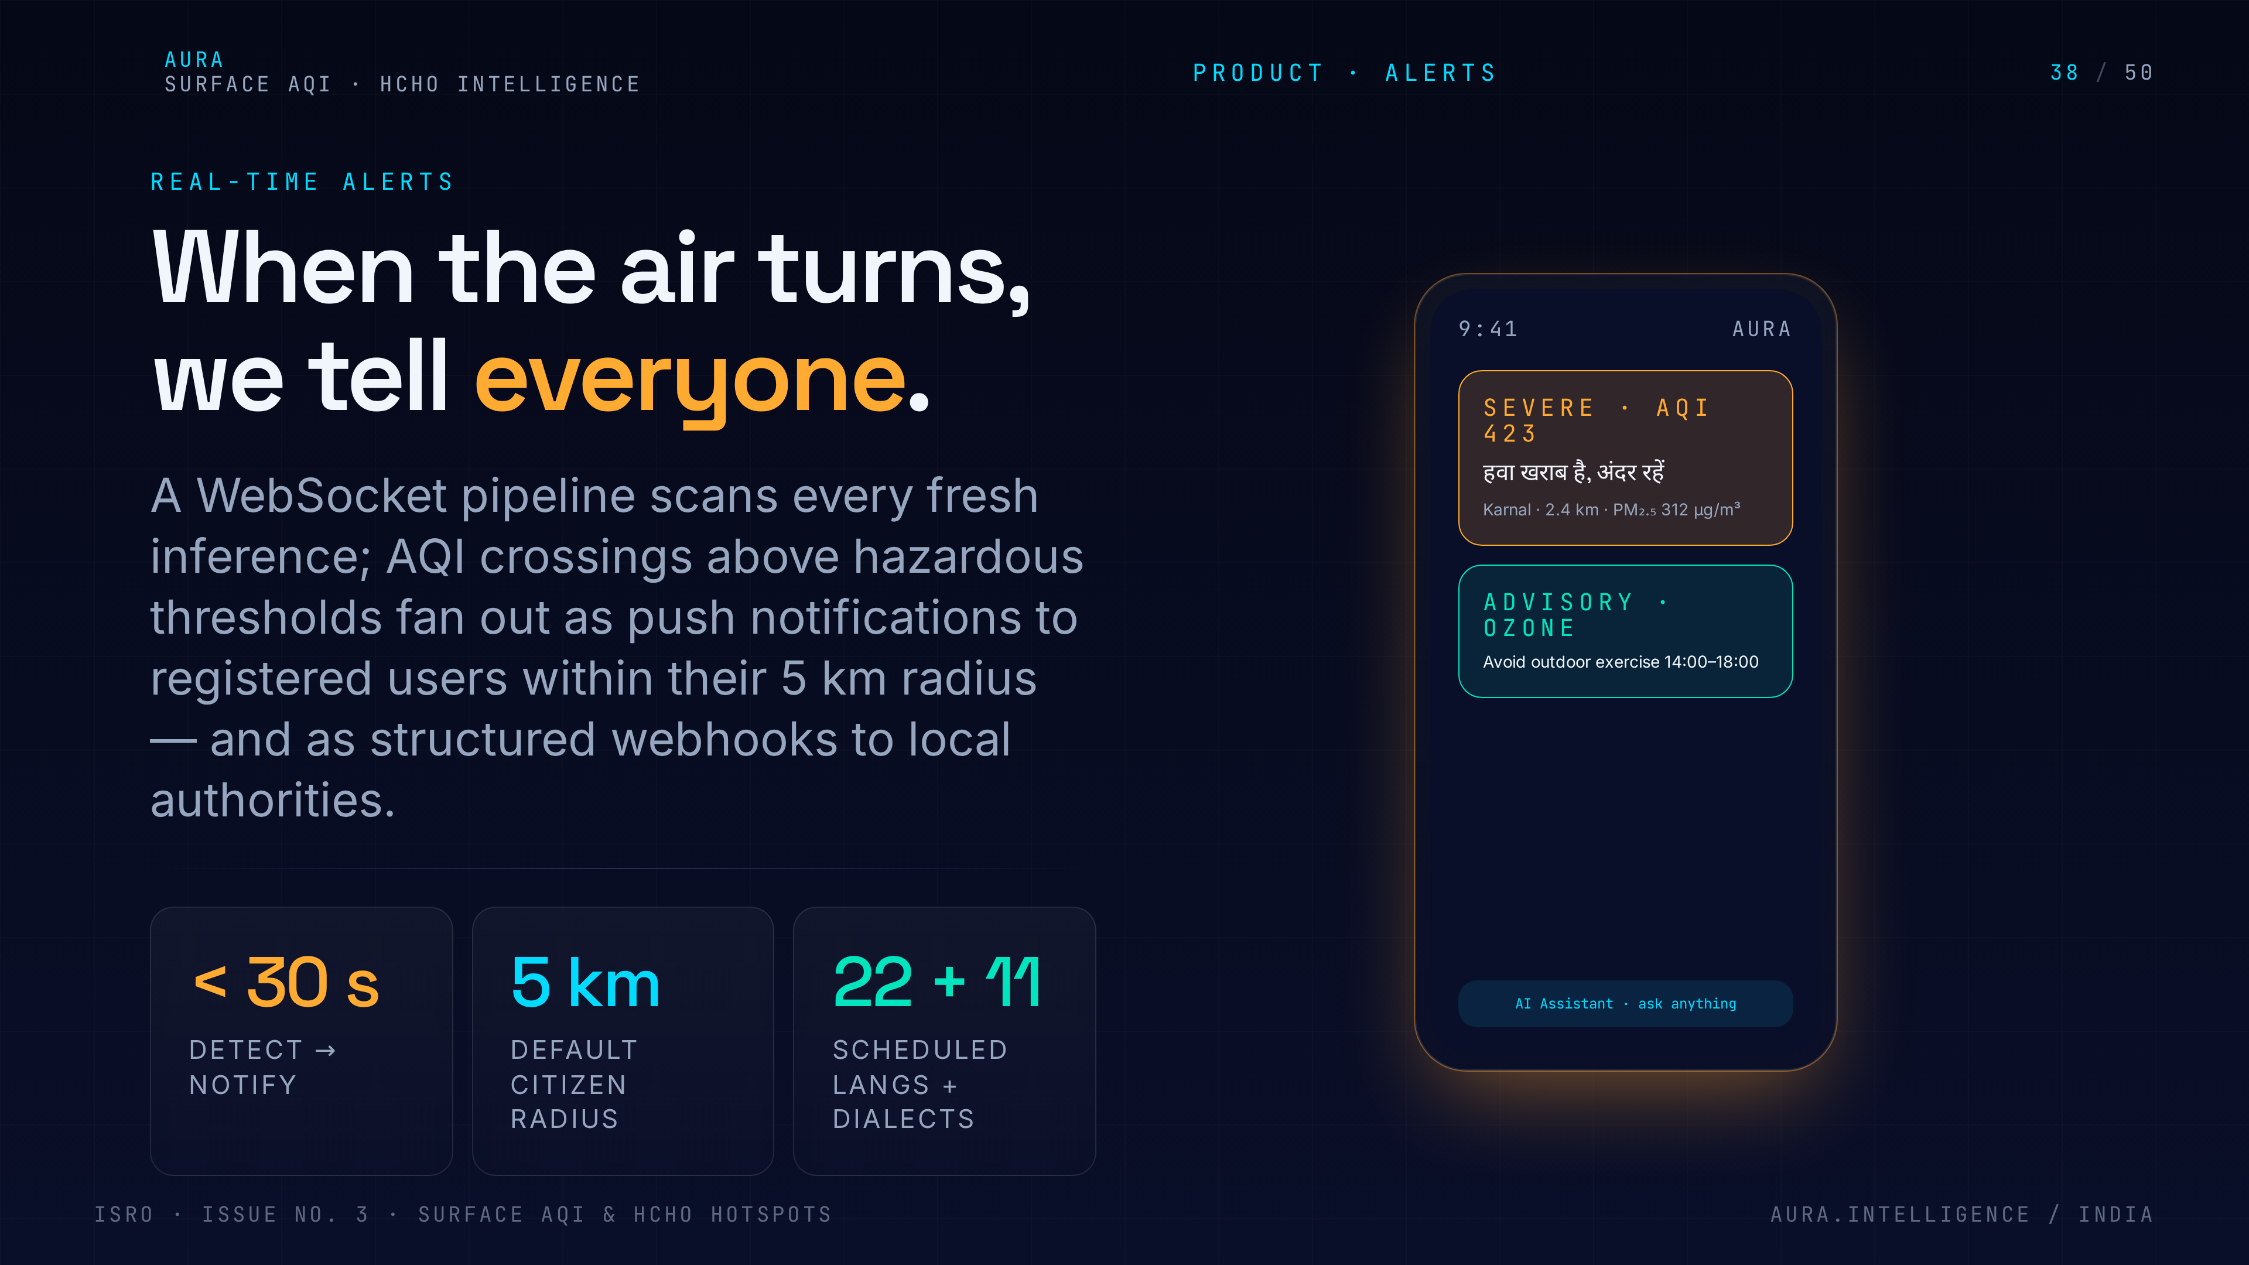
Notes:
38. Real-time alerts
Real-time alerts. Threshold-based, localised to the pincode, multi-channel — push, SMS, WhatsApp, IVR. Latency target under fifteen minutes from satellite overpass.

Slide 39
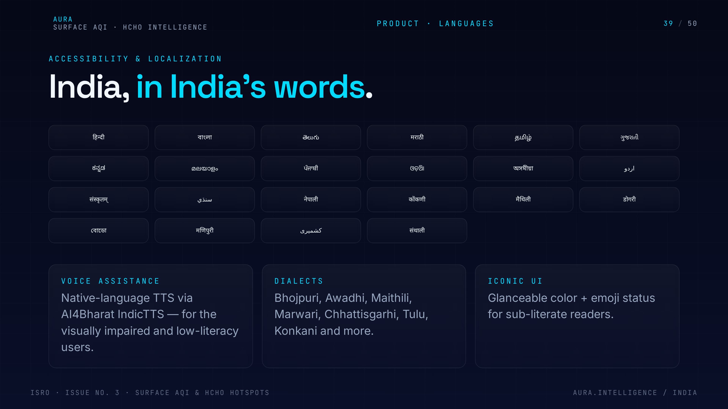
Notes:
39. 22 languages
22 official languages, with TTS for low-literacy users. Health advisories are translated and reviewed, not just machine-converted. Accessibility is a first-class feature.

Slide 40
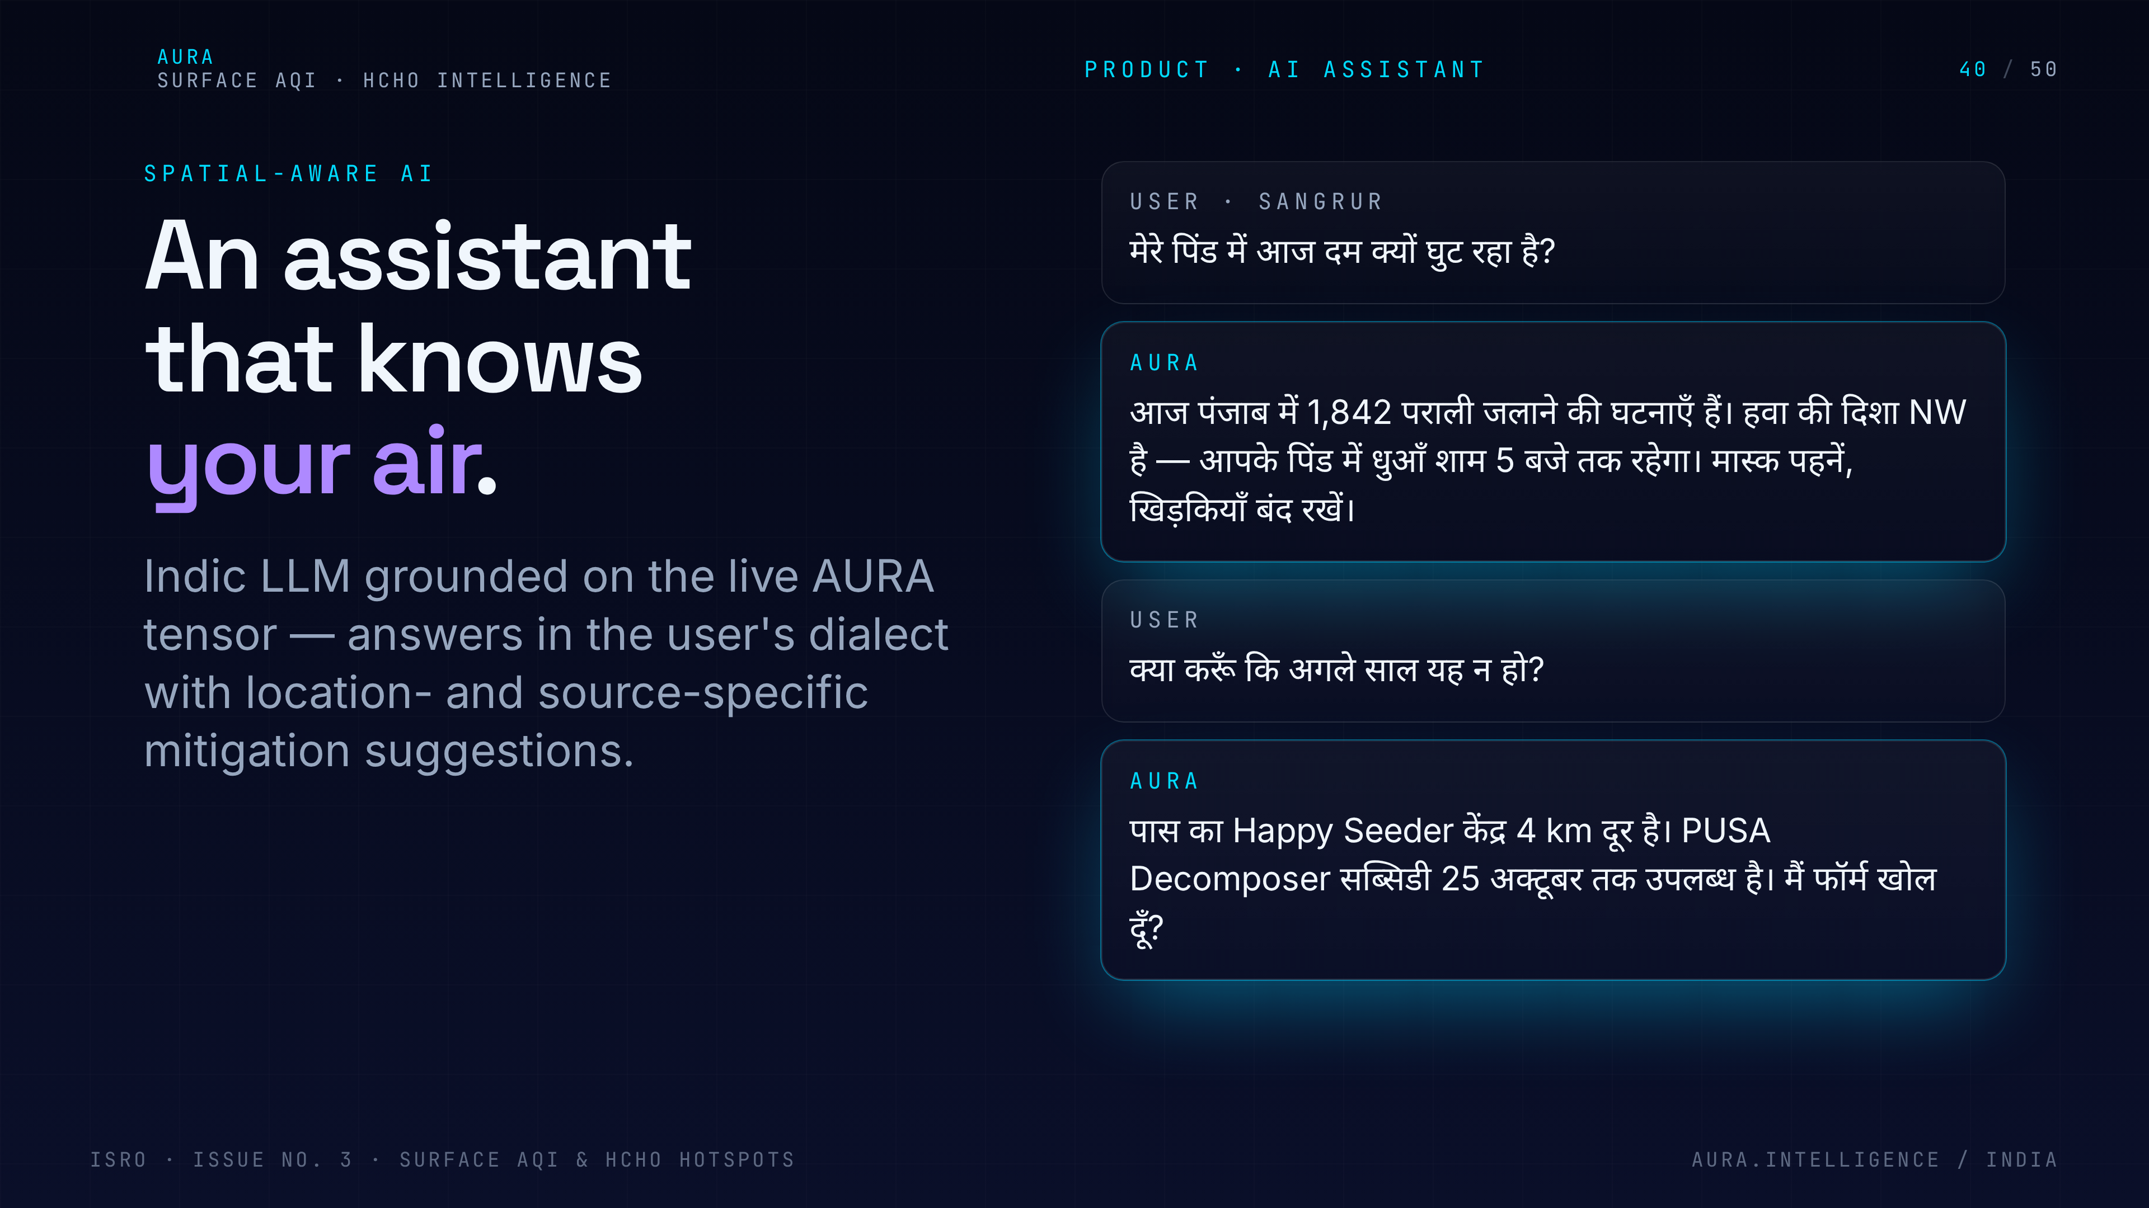
Notes:
40. AI Assistant
AI Assistant on top of the data. Ask 'why is the air bad today?' and it explains the satellite evidence, the likely sources, and the recommended action. Built on the Lovable AI Gateway.

Slide 41
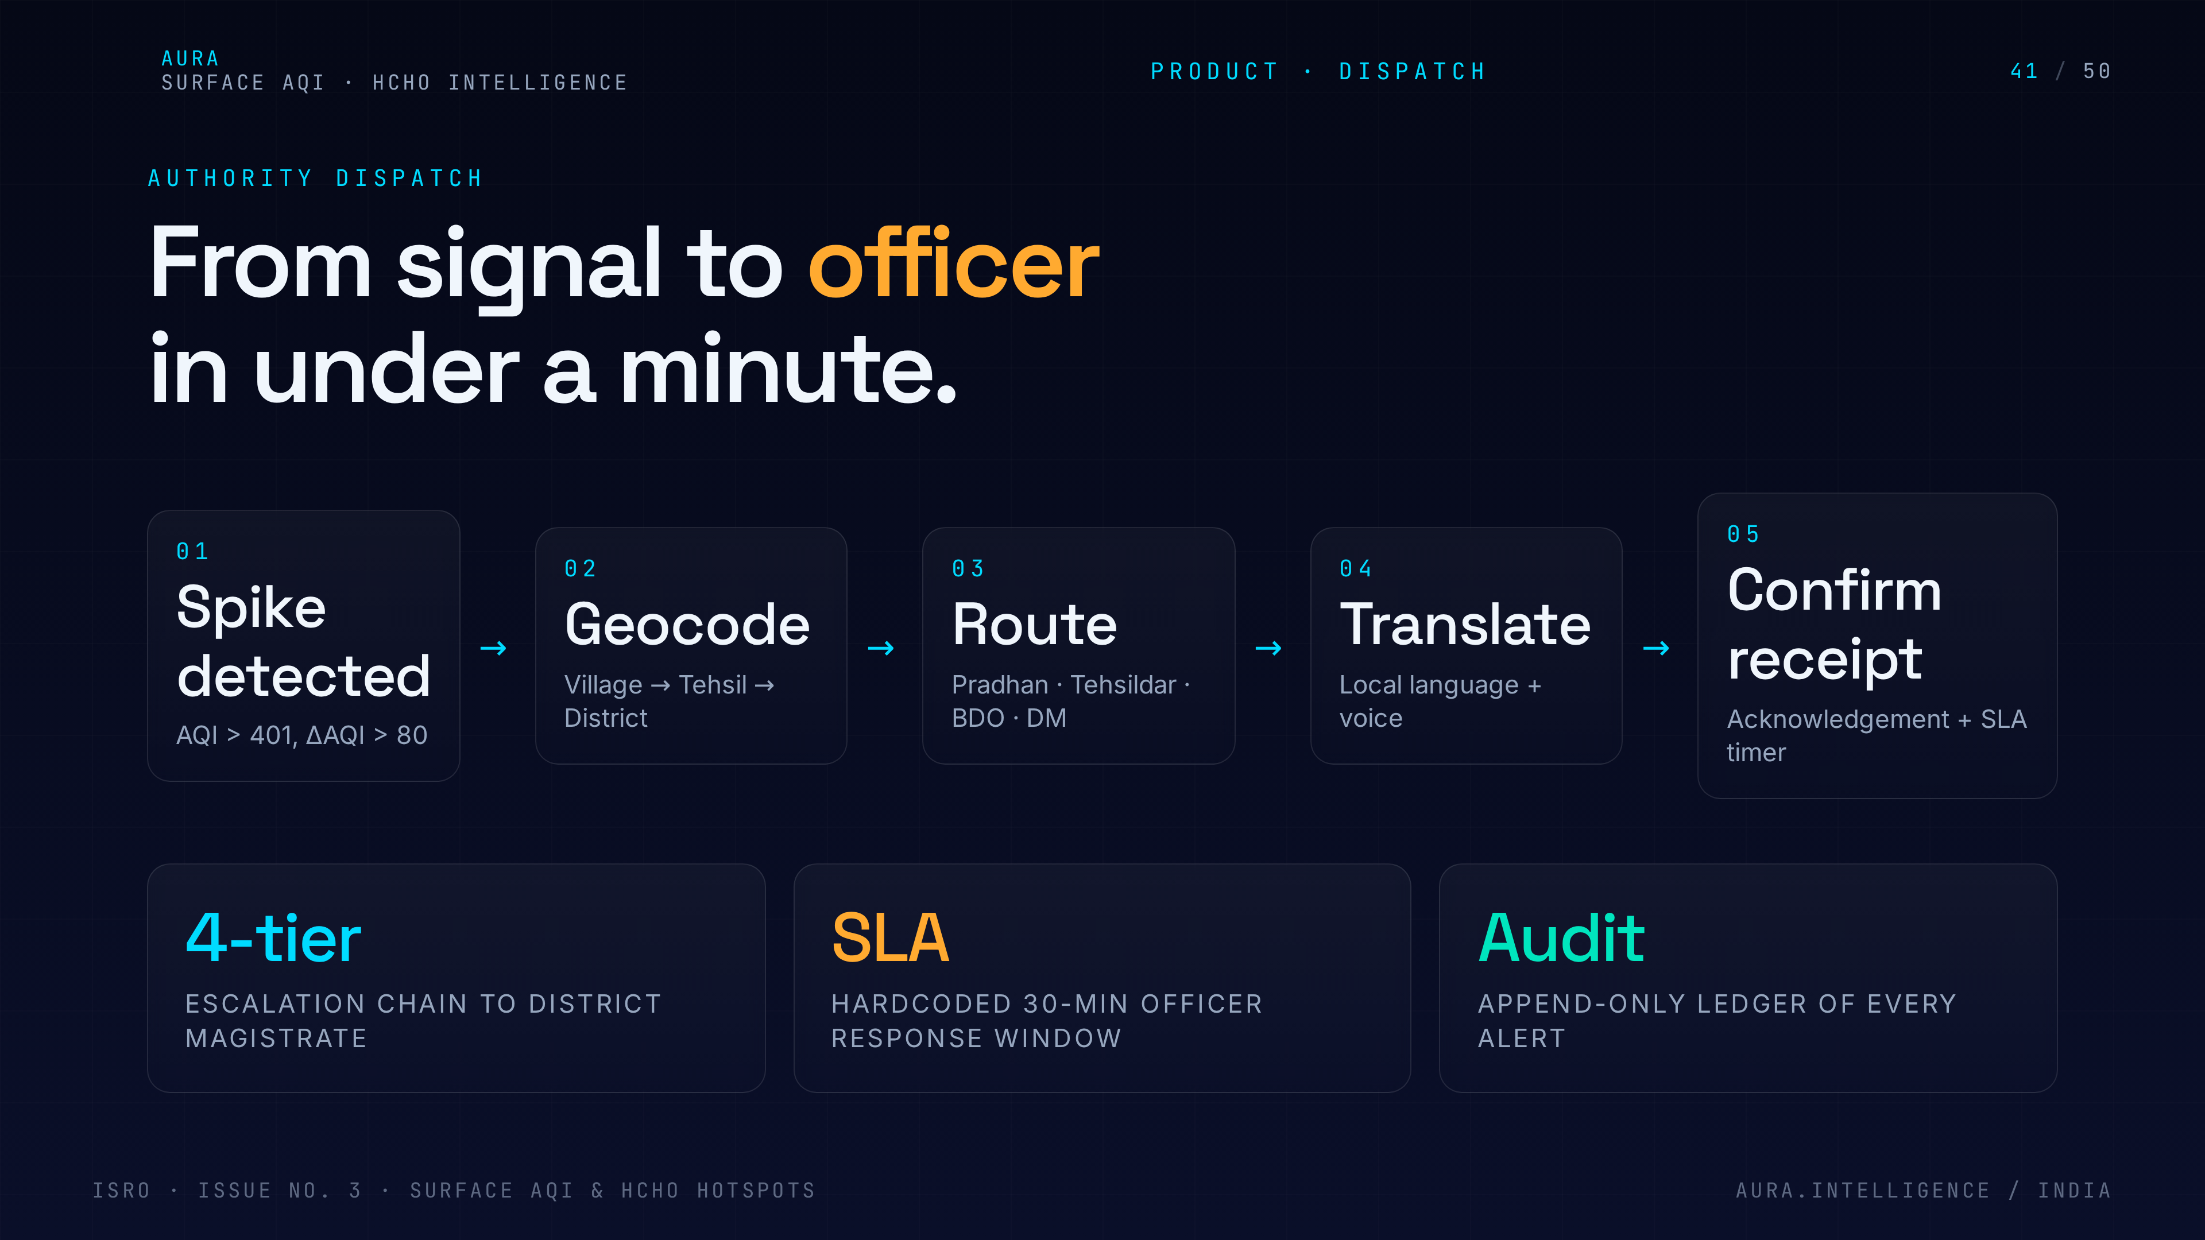
Notes:
41. Authority dispatch
Authority dispatch. When a hotspot crosses a policy threshold, the system files a structured alert to the four-tier authority chain — panchayat, district, state pollution board, MoEFCC.

Slide 42
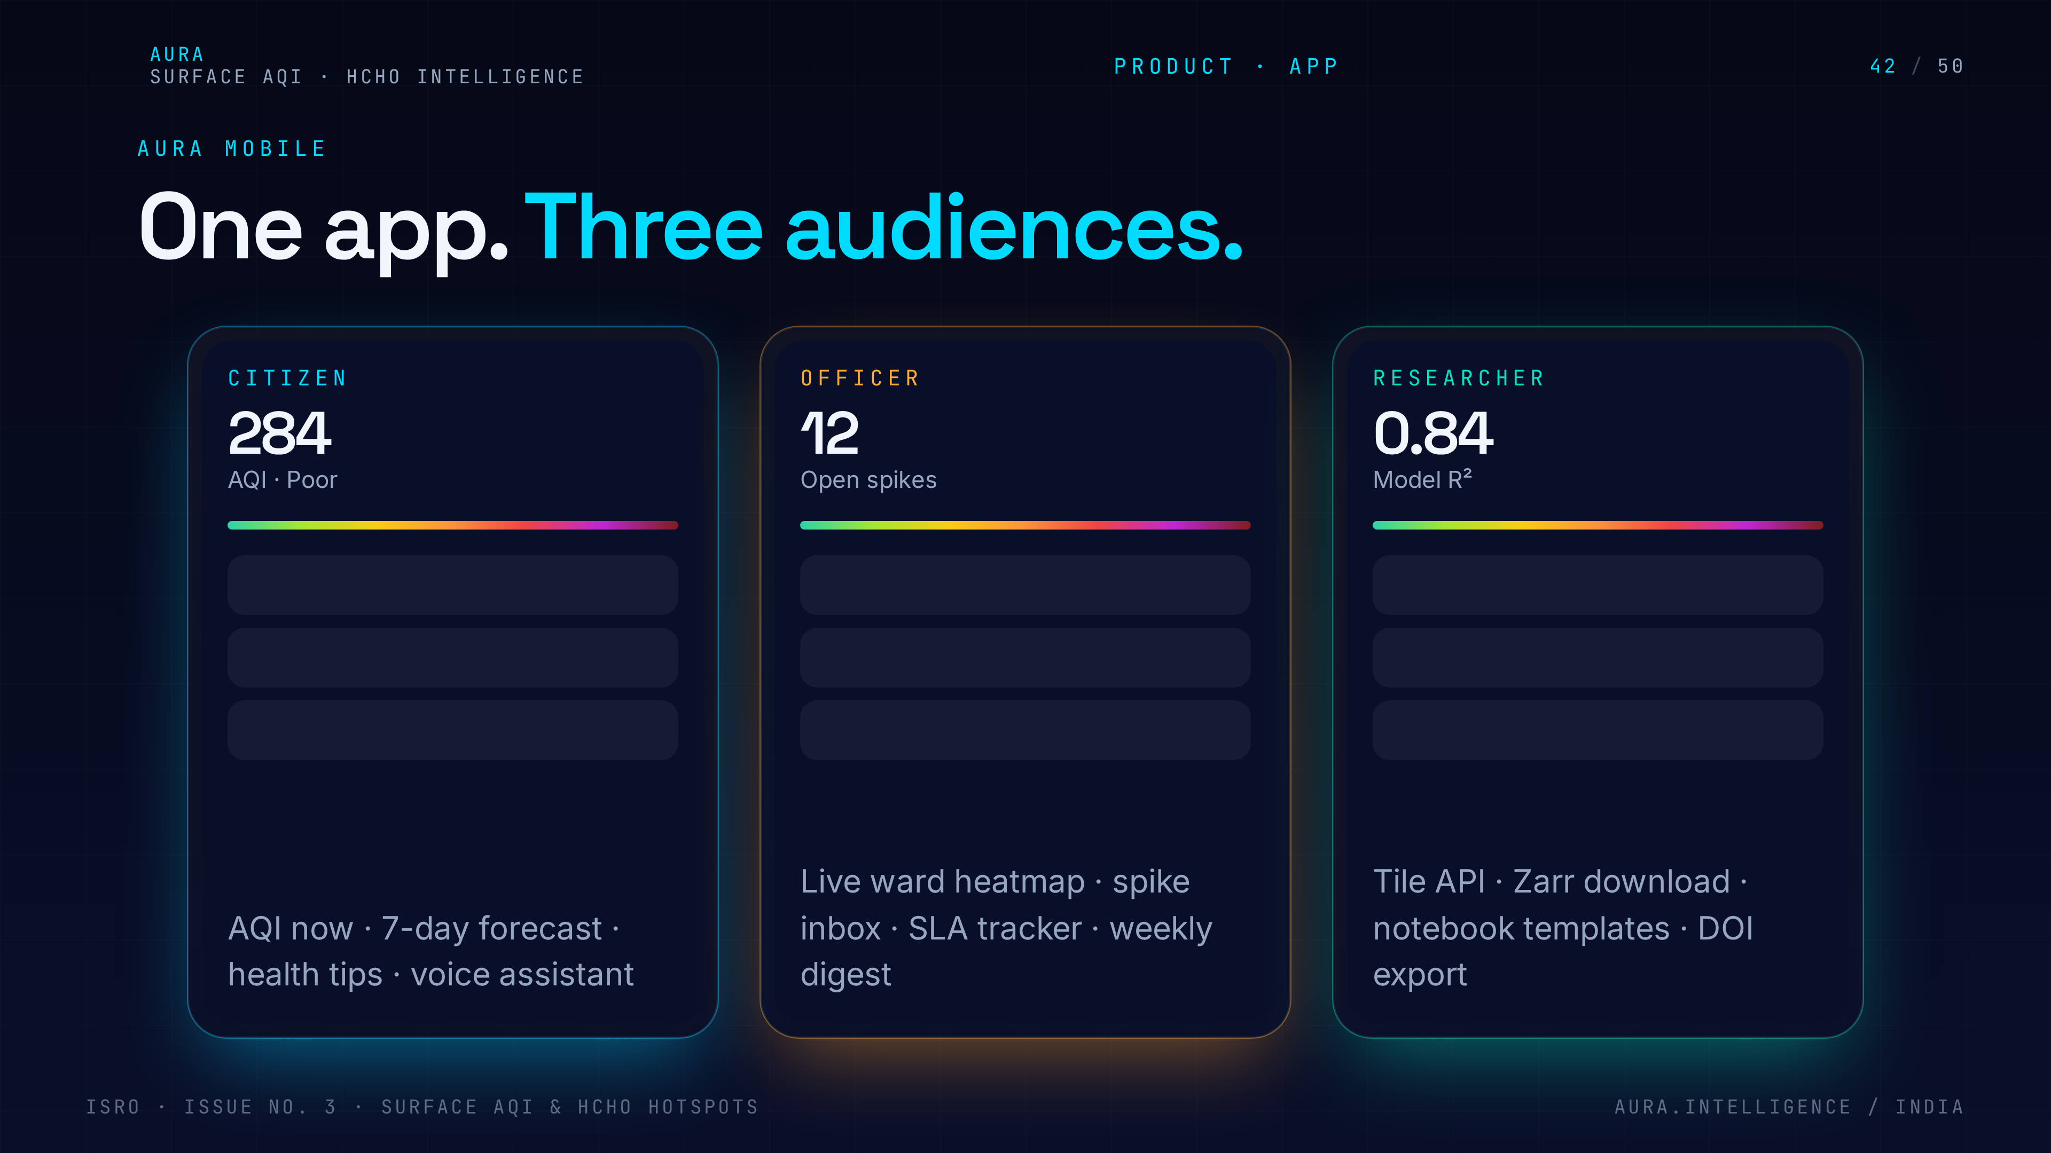
Notes:
42. Mobile app screens
Mobile app screens. Walk through the four hero flows: AQI now, forecast, alerts, and the assistant. Keep the demo to under sixty seconds in the live pitch.

Slide 43
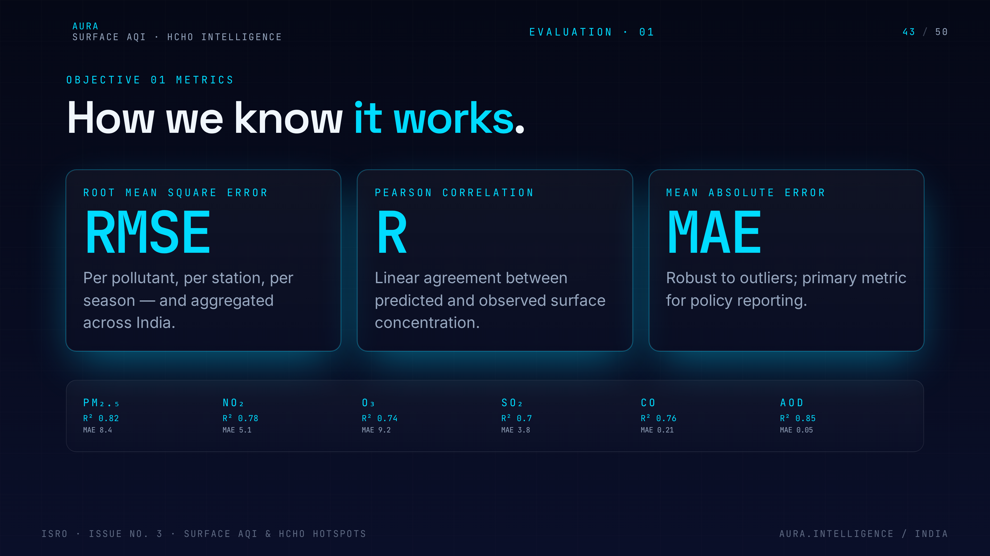
Notes:
43. Obj 1 metrics
Objective 1 evaluation metrics. R-squared, RMSE and MAE versus CPCB; spatial coverage versus existing CPCB-only maps; latency from overpass to surface map.

Slide 44
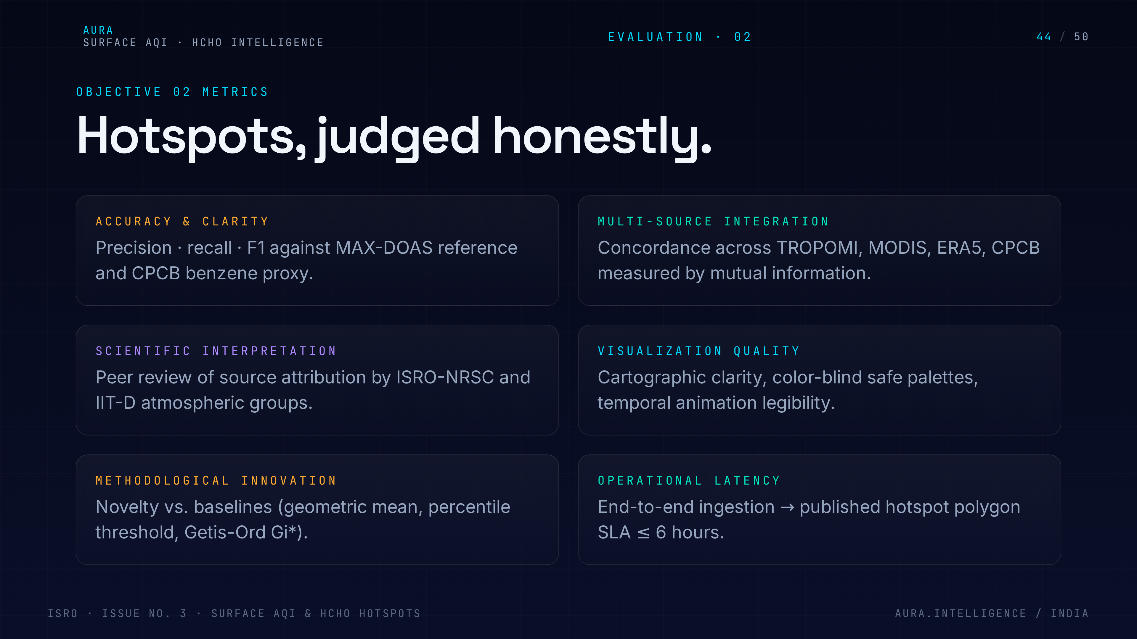
Notes:
44. Obj 2 metrics
Objective 2 evaluation metrics. Hotspot precision and recall against MODIS fire ground truth, false-positive rate in non-burning seasons, attribution accuracy via back-trajectory.

Slide 45
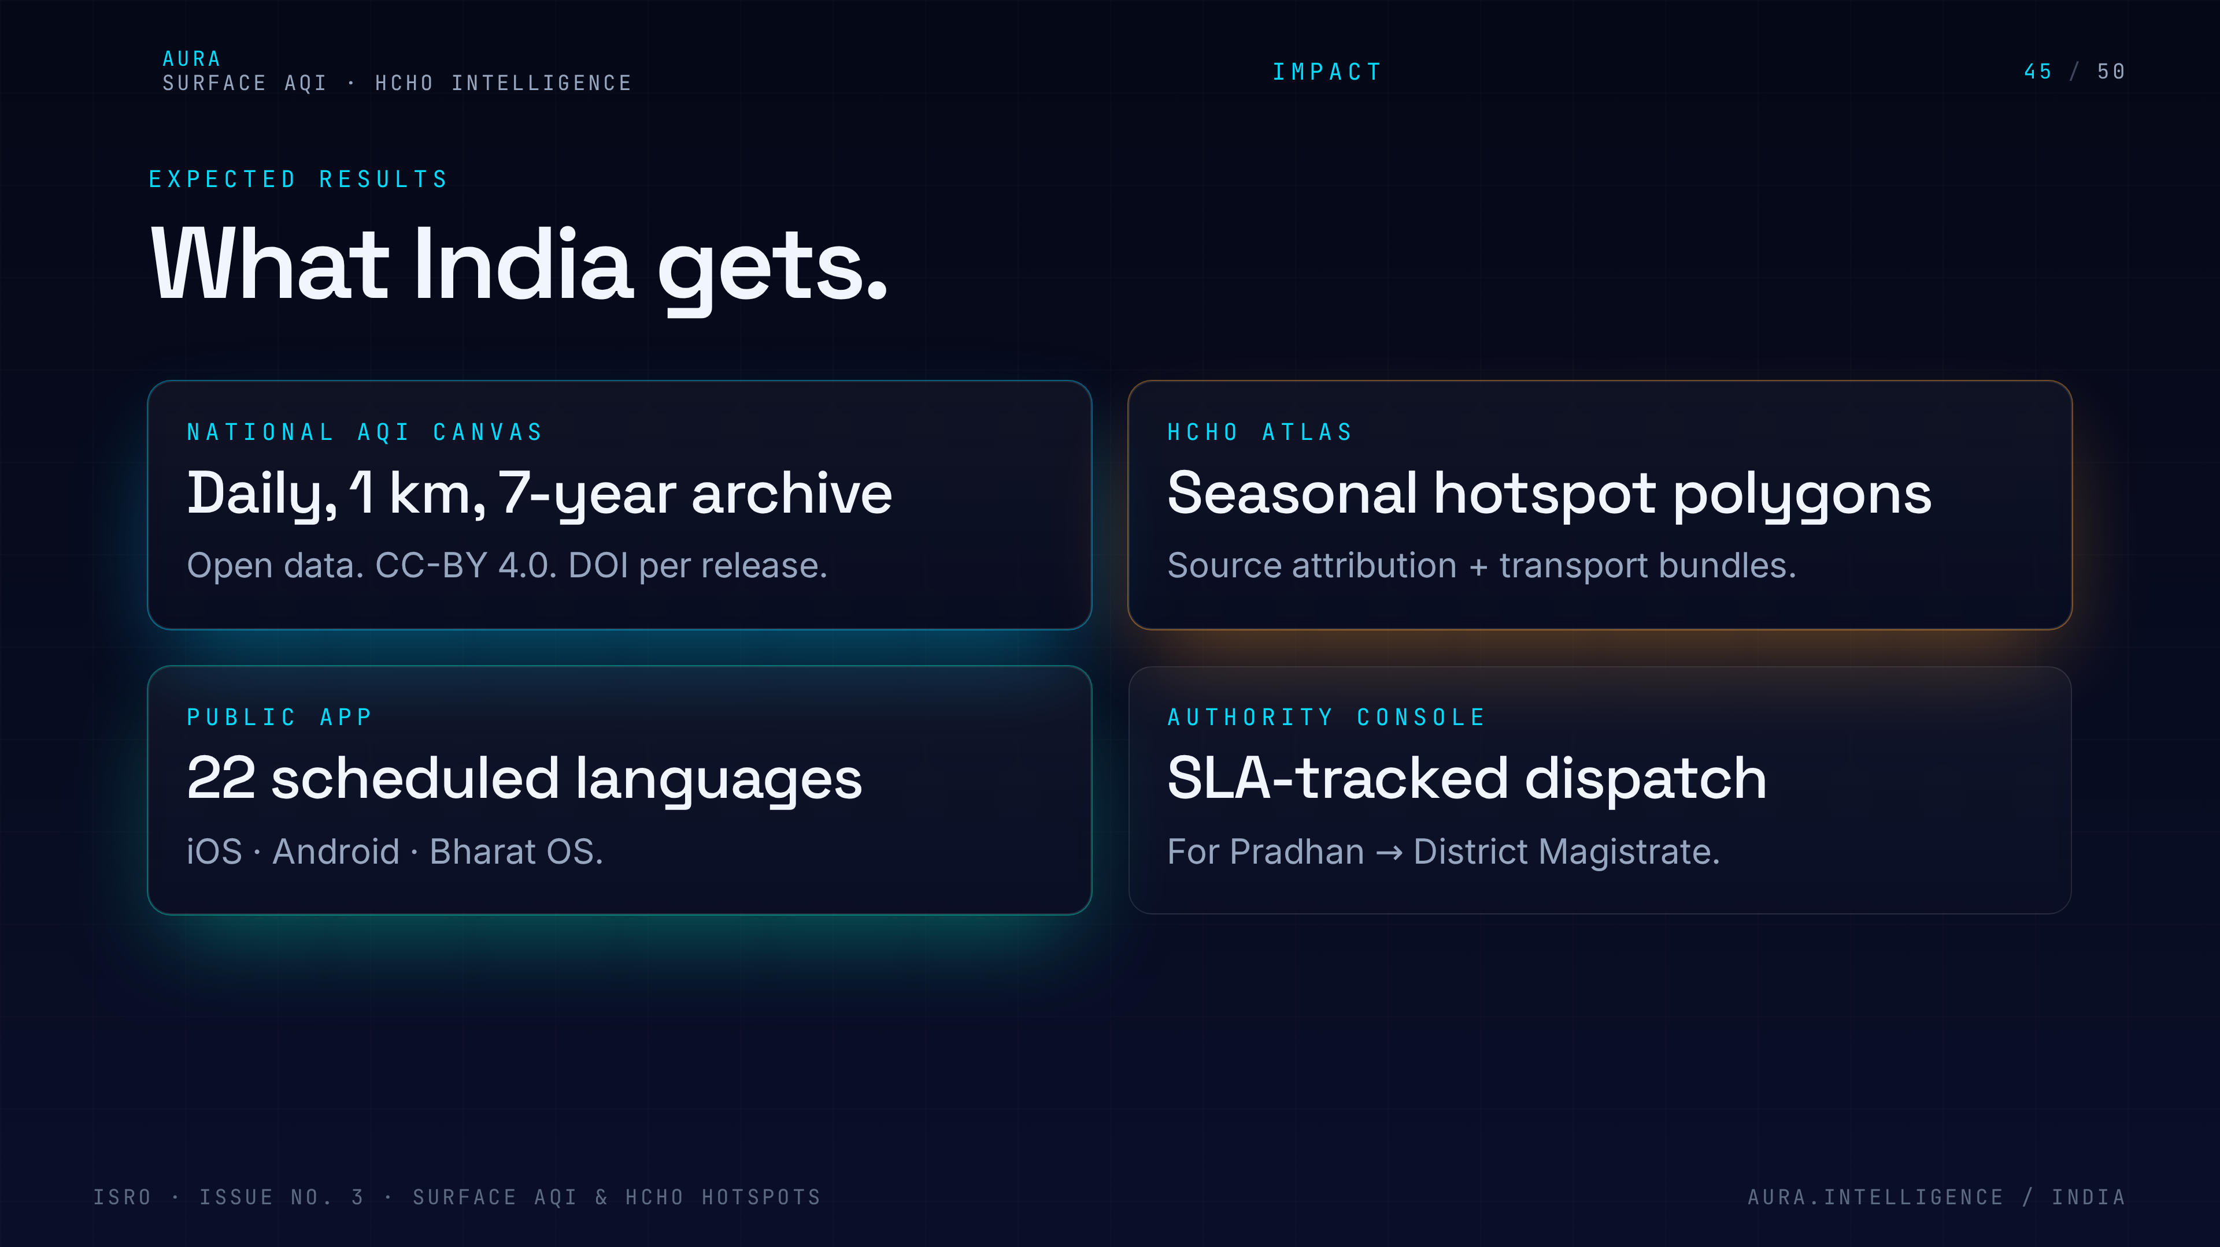
Notes:
45. Expected results
Expected results. 1 km surface AQI for 100% of India, HCHO hotspots refreshed daily, and a measurable reduction in alert-to-action time for participating authorities.

Slide 46
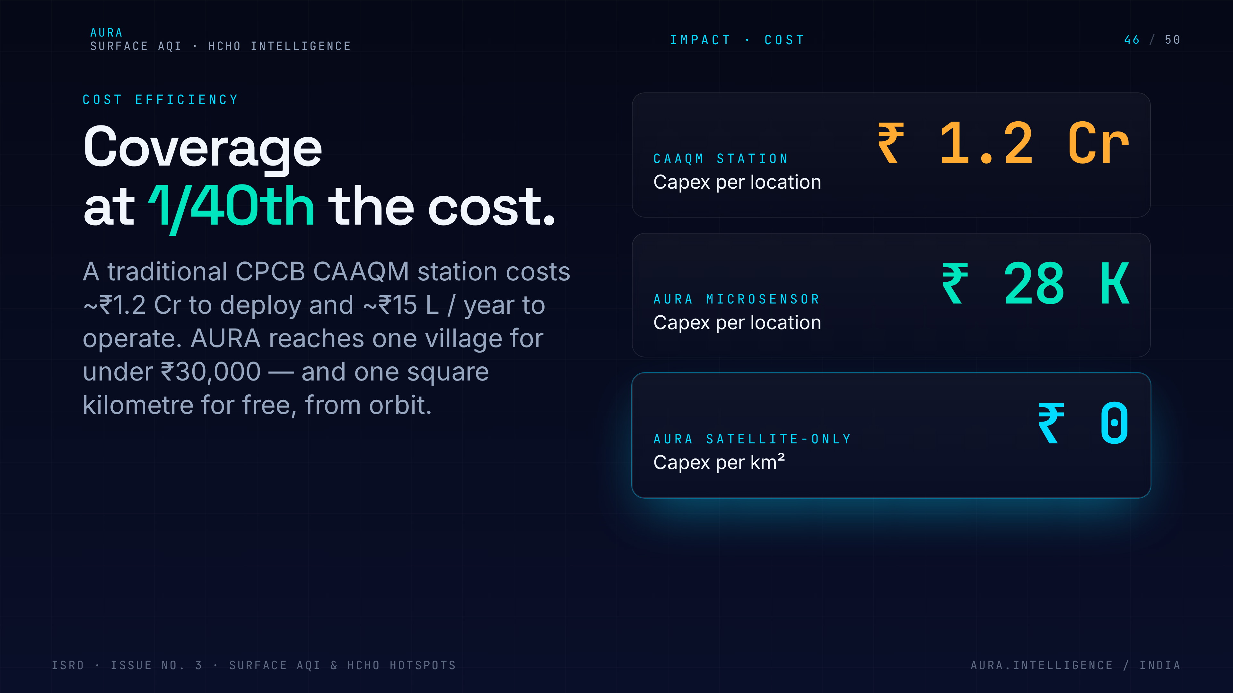
Notes:
46. Cost efficiency
Cost efficiency. A new CPCB station costs roughly ₹1.5 Cr; one satellite pipeline covers the country for a fraction of that. This is the slide that wins the budget conversation.

Slide 47
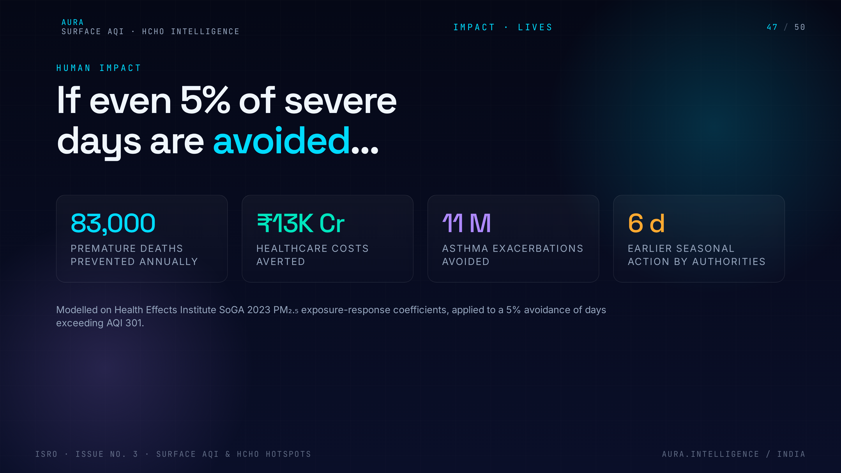
Notes:
47. Human impact
Human impact. Asthma patients, outdoor workers, schoolchildren, pregnant women — name the beneficiaries. Air quality intelligence is a public good.

Slide 48

Notes:
48. 24-month roadmap
24-month roadmap. Quarters 1-2 data + model, 3-4 validation + product, 5-6 pilot in two states, 7-8 national rollout. Reviewers want to see realistic gates.

Slide 49
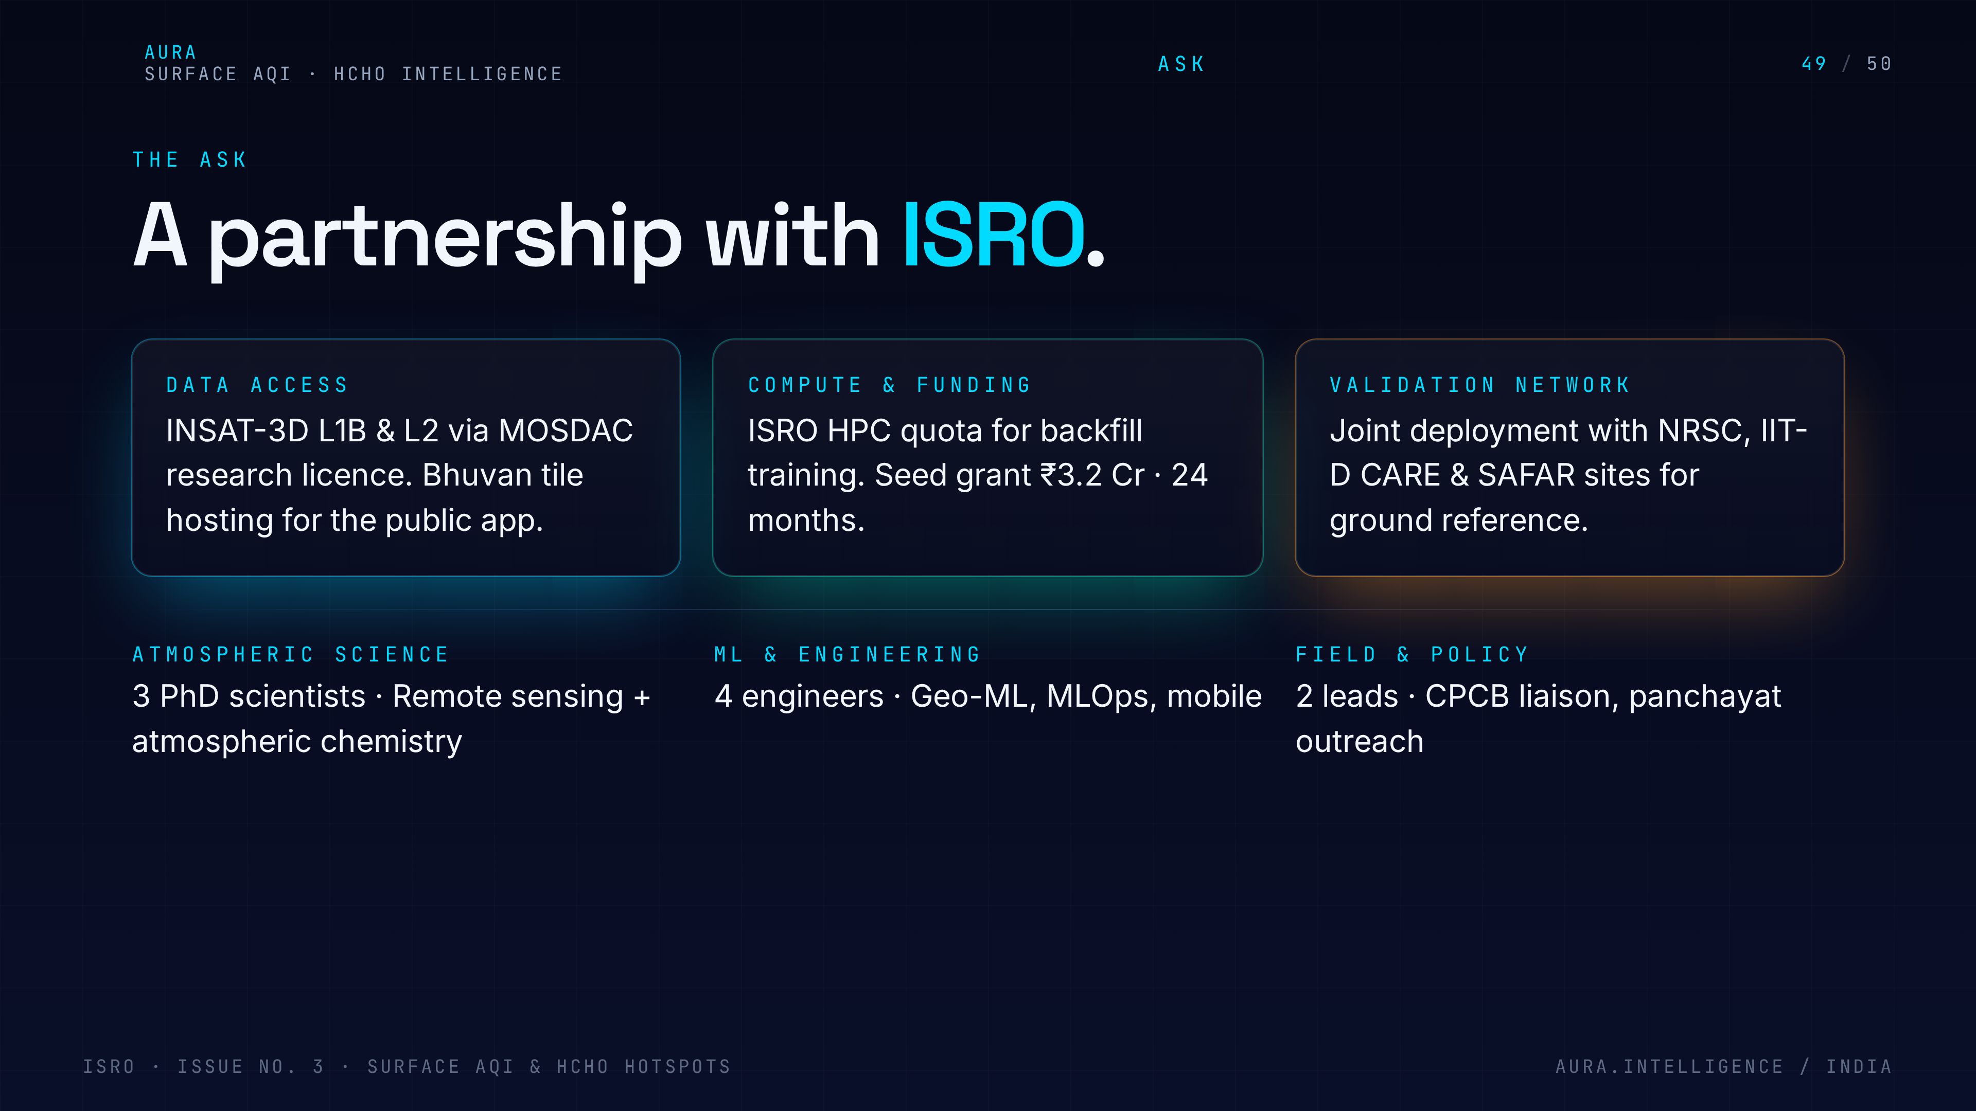
Notes:
49. Partnership ask
Partnership ask. ISRO data access, CPCB validation partnership, MoEFCC for the alerting integration, and seed funding for the microsensor pilot. Be specific.

Slide 50
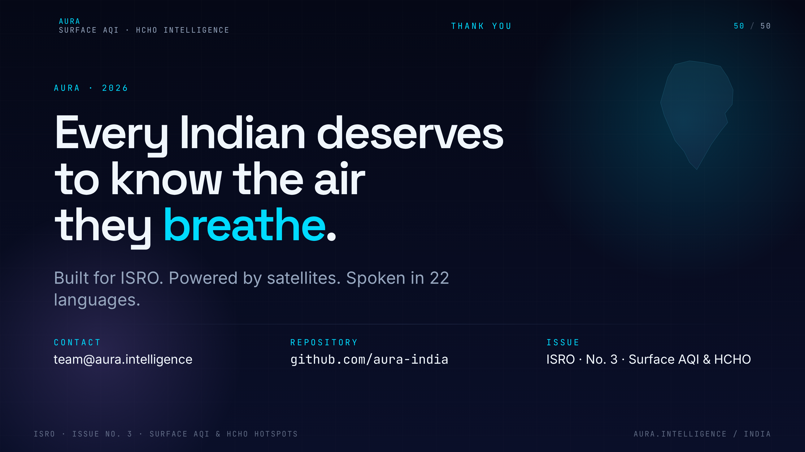
Notes:
50. Thank you
Close confidently. Thank the panel, restate the vision in one line — 'every breath, mapped from space' — and invite Q&A.

